Slide 1


Email Update
HyLy & CRM

Slide 2
Overview
To ensure the best possible customer experience, and adherence to the 2003 CAN-SPAM Act, we’ll be updating a few of our email procedures – sending specific communications out of specific platforms and categorizing our emails in order to facilitate the creation of an email preference center.

Slide 3

Outline
Issue Overview
Universal Preference Center
Where Do I Send From?
Quiz
Categorization and HyLy Update
What’s Next?
Helpful Resources
Q&A Session

Slide 4
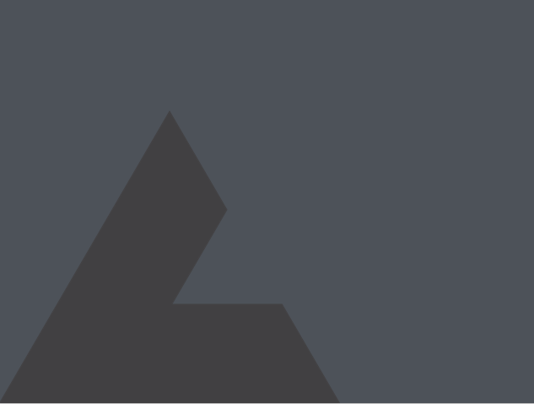
SECTION 1
Issue Overview

Slide 5
Overview
What are we solving for?
Because we're sending emails from multiple systems, customers need to unsubscribe multiple times.

Slide 6
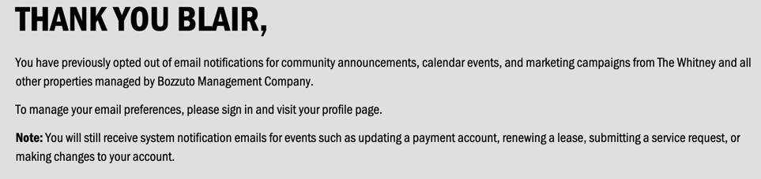
Overview
What are we solving for?
Yardi’s opt-out messaging is standard for all of their customers, so it can’t be changed, and implies that you can opt-out of multiple lists (corporate and property specific), only their system does not allow for this.

Slide 7
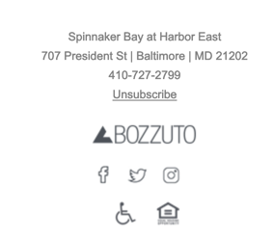
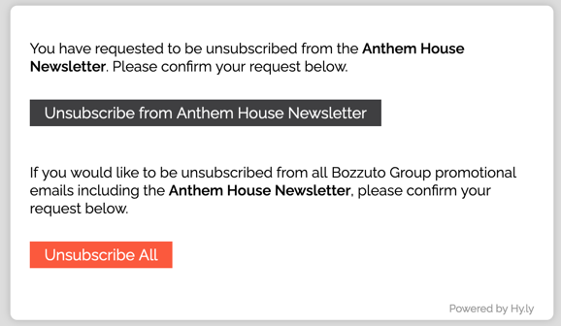
Overview
What are we solving for?
HyLy takes you from the “unsubscribe” link in the email to a rudimentary preference center. You can either unsubscribe from the one property you received the email from or all Bozzuto communications, only this would include all other communities they had signed up for (including corporate).

Slide 8

Considerations
Why is this a problem?
2003 CAN-SPAM Act – “prohibits sending emails to a recipient after an explicit response that the recipient does not want to continue receiving messages” (I.e. opt-out)​
73,066 unsubscribes over the past 12 months
Bozzuto.com contact form complaints – 36 last year
Notes:
Only send an eblast if you have new and compelling information to share. On average, open rates fall as more eblasts are sent because email fatigue sets in.

Slide 9
SECTION 2
Universal Preference Center

Slide 10
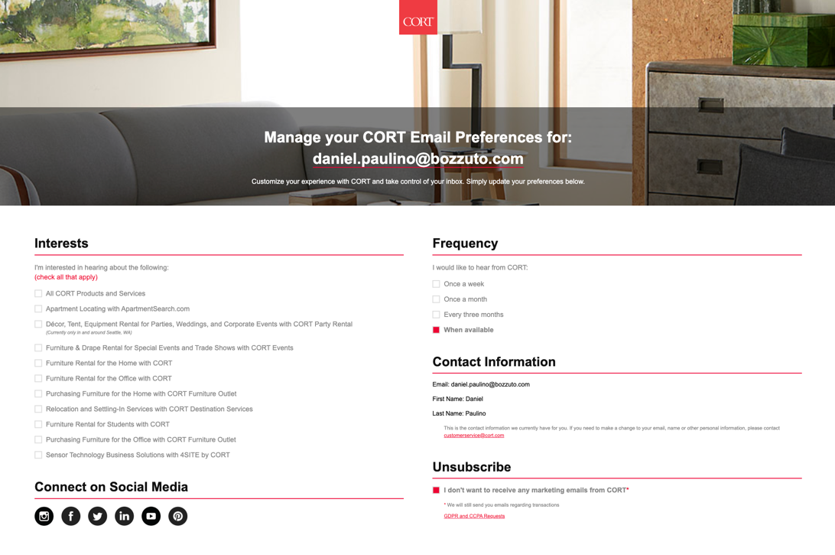
What is a preference center?
Choose your own communication
A prospect or resident can hit “unsubscribe” in the body of a HyLy email and is taken to a series of checkboxes where they can customize the types of email communications that they’d like to receive and for which communities.

Slide 11
SECTION 3
Where Do I Send From?

Slide 12
Where Do I Send From?

Slide 13

When do I send from CRM?
Essential Communications
Any One-on-One Communications
Prospect follow ups
Maintenance requests
Lease renewals
Etc.
Community Maintenance
Trash chute cleaning
Road closures
Etc.
Emergency Communications
Fire
Security threats
Etc.

Slide 14
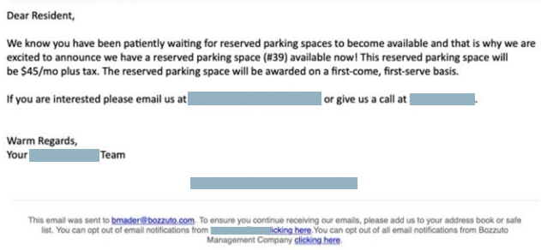
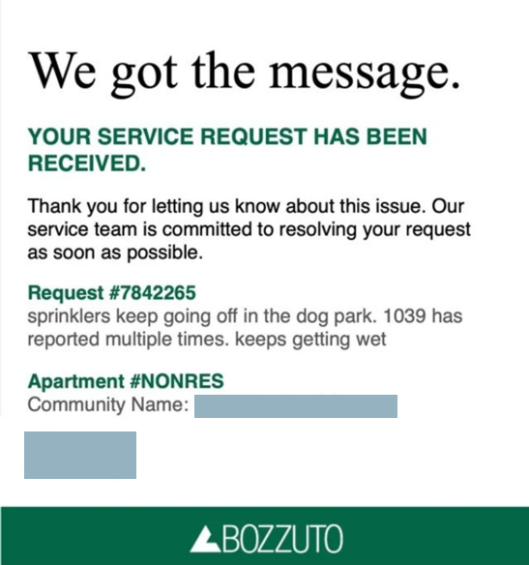
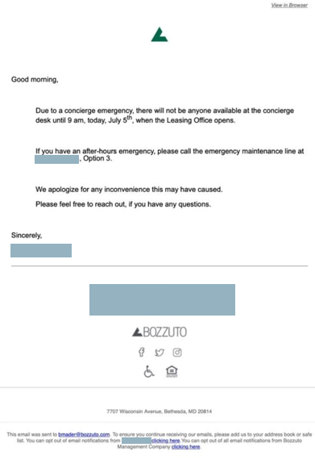
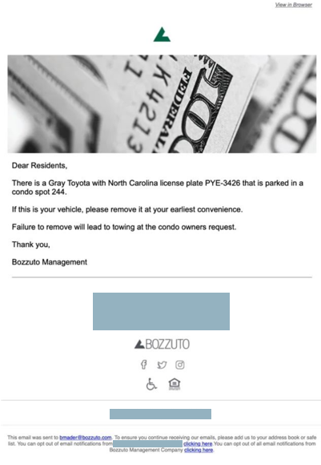
CRM Samples
Only the Essentials

Slide 15

When do I send from HyLy?
Optional Communications (Both Resident and Prospect)
Promotions
”2 Months Free”
Featured Floor Plans
Etc.
Events
Open House
Resident Pool Party
Etc.
Community Updates
Community Newsletters
New Retail
Charitable Opportunities
Etc.

Slide 16
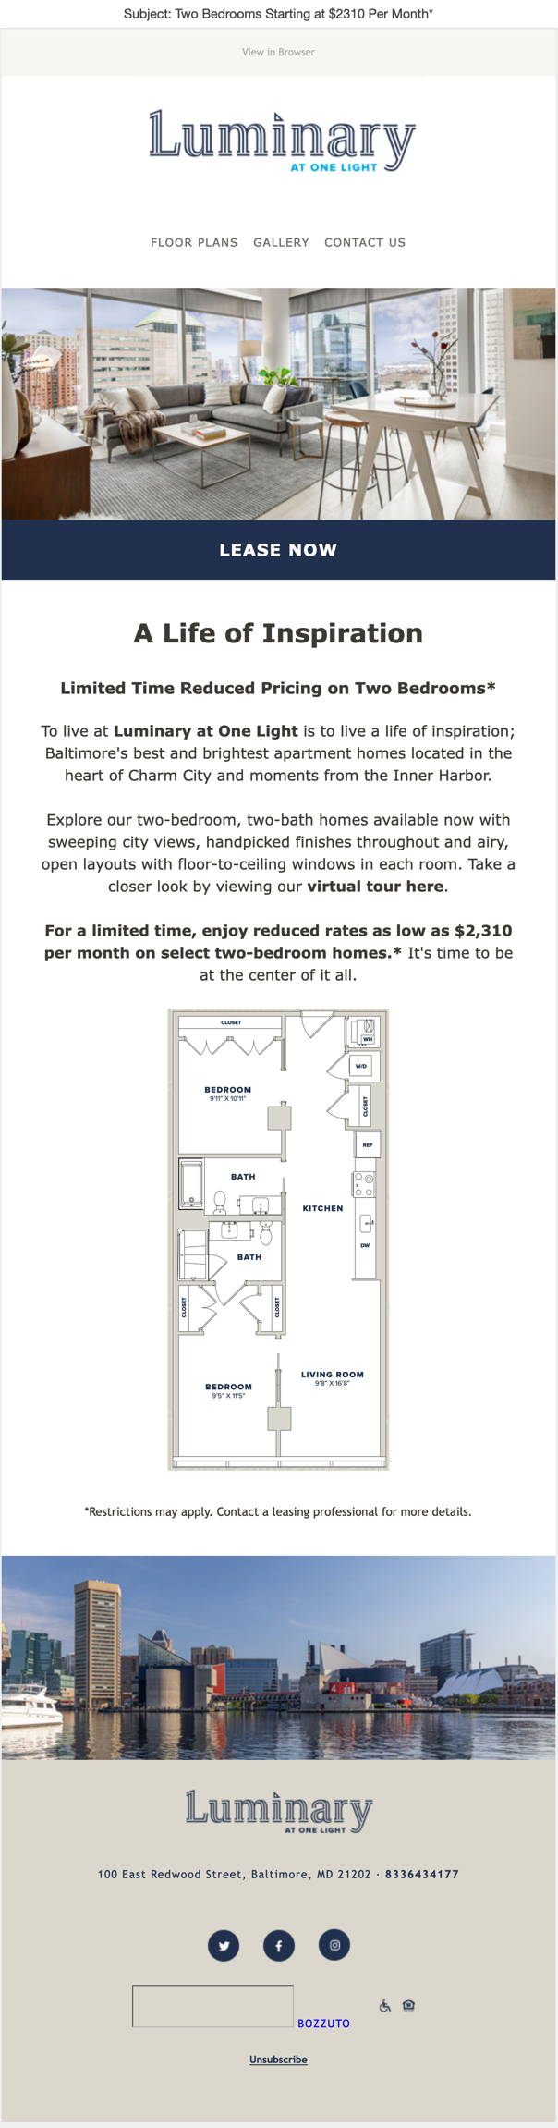
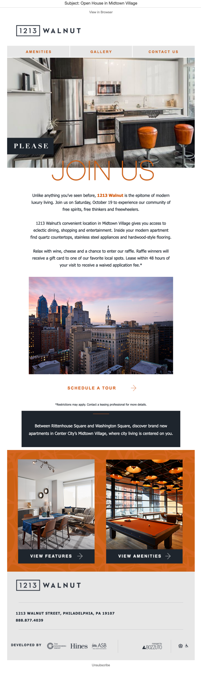
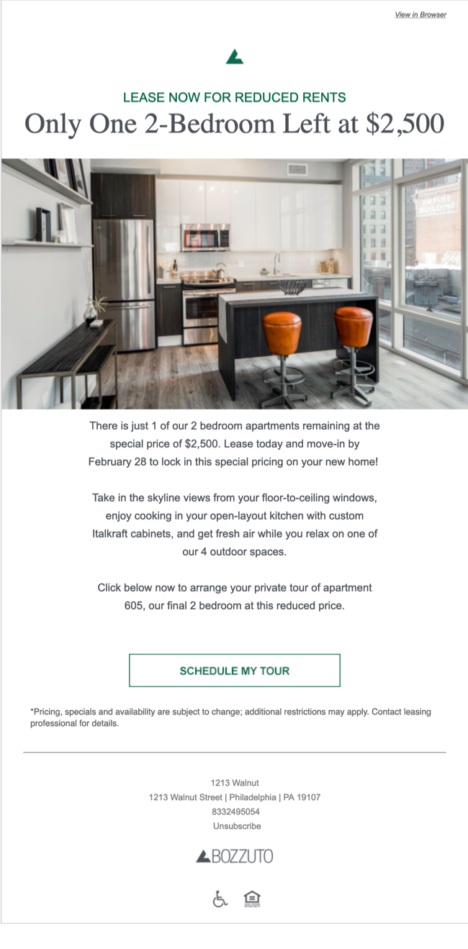
HyLy Samples
The Fun Stuff

Slide 17
SECTION 4
Quiz Time!
CRM vs HyLy

Slide 18
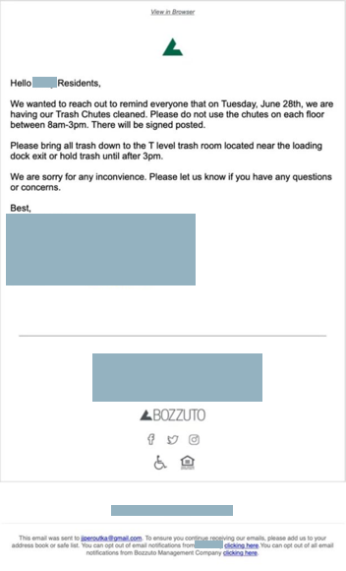
Email #1
Trash Chute Cleanout

Slide 19
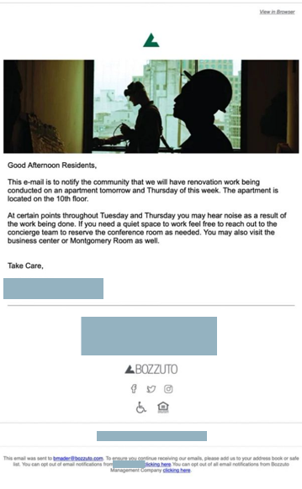
Email #2
Renovations

Slide 20
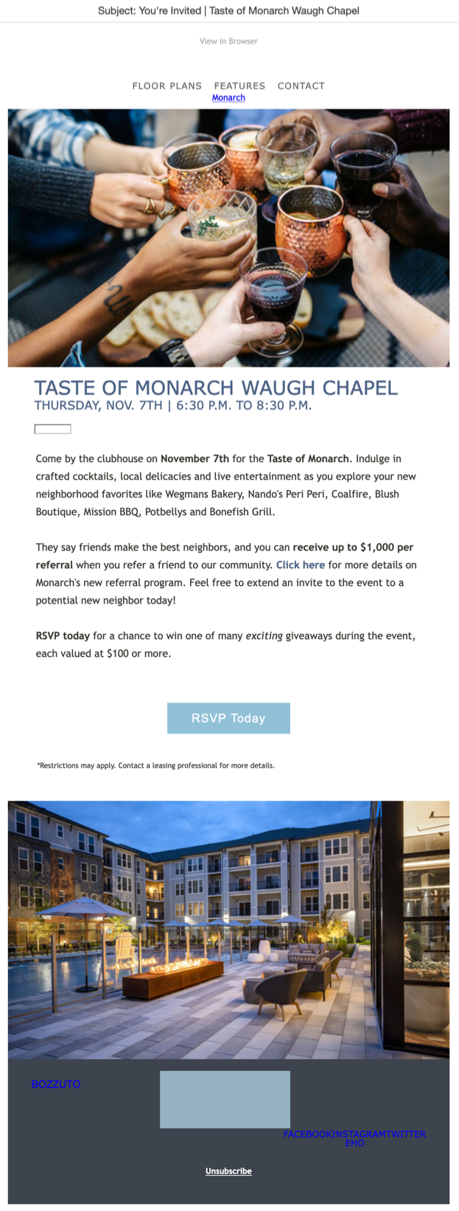
Email #3
Resident Referral Event

Slide 21

Email #4
$500 Off After Touring

Slide 22
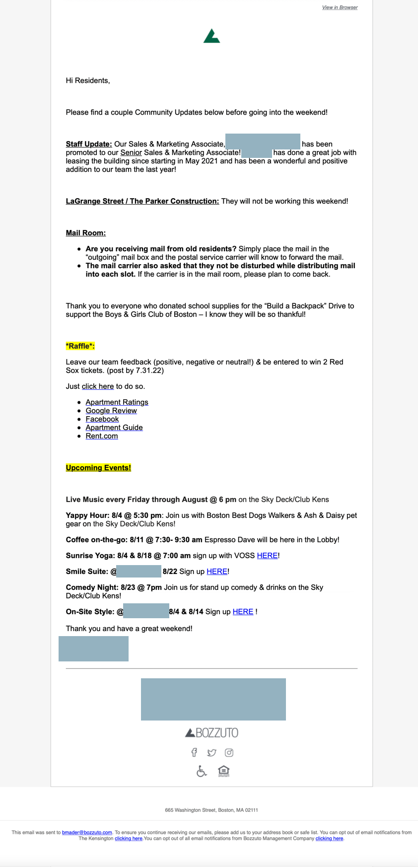
Email #5
Resident Updates

Slide 23
SECTION 5
Email Categorization & HyLy Update

Slide 24
Categories + HyLy
Now that we know which types of emails come from which platforms we need to label them, and HyLy’s new interface can help.

Slide 25
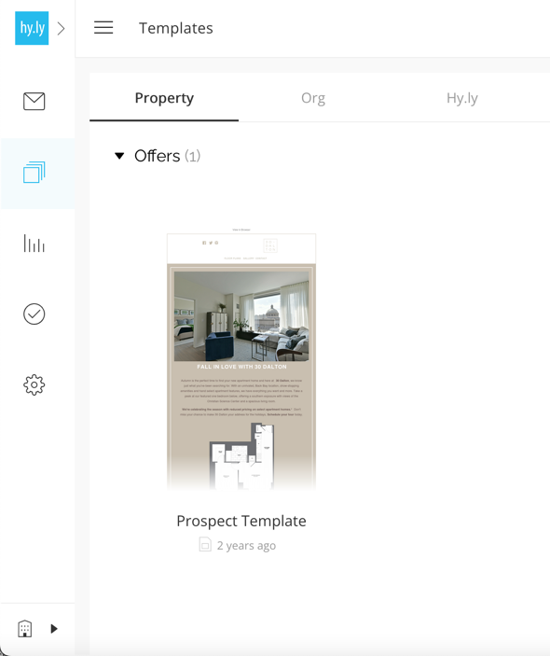
Categories + HyLy
One new step – choose what type of email you’re sending, before you pick your template.

Slide 26
SECTION 6
What’s Next?

Slide 27

What’s Next?
Email Preference Center
New Email Templates
hyTour integration into new HyLy dashboard
Upgrade preference center – texts, 3rd party vendors, and more…

Slide 28
SECTION 7
Helpful Resources

Slide 29

Helpful Resources
Go to BOLD → Marketing → Topics → Useful Resources → hyBlast Email Communication Resources
5 Steps to Writing Engaging Content: Step by step guide to ensure your team writes content that keeps your prospects engaged.
Marketing Grammar 101: Know the ins and outs of writing copy.
Fair Housing: How to stay in line with fair housing guidelines when writing.
My Checklist: Before you send your email, be sure to review your checklist.
hyBlast Refresher Guide: focus on the frequently asked questions and areas of opportunity in Hyblast communication

Slide 30
Questions?

Slide 31
Thank You
Blair Mader – Bmader@Bozzuto.com

