Slide 2


Facebook and HootSuite a webinar for champions

Slide 3
As a result of this workshop YOU will be able to:
Consistently perform to expectations
Effectively manage your Internet curb appeal
Strategically identify way to increase the quality of your posts
Efficiently manage your time
Dramatically increase interaction between residents, the community and Bozzuto
…with Facebook & HootSuite!
What is in it for me?
Notes:
.

Slide 4



Our Vision
Every front office employee will be capable of using Facebook managed with HootSuite, as a tool to generate more potential customer leads, increase resident retention and build a community where our resident lives online.

Slide 5

Our Strategy You need to know the answers to these questions
What is the difference between a Fan page and a Friend page?
How often should I post?
Who & what should I post?
How do I handle a “hot” post?
What is HootSuite and how do I use it?
How will my property be measured on our performance?
Notes:
Why do you think social media use is important to our business?
_____________________________________________________________________________________________________________________________________________________________________________________________________________________________________________________________________________________________________________________________________________________________________________________________________________________________
What do you want to know or have questions about?
_____________________________________________________________________________________________________________________________________________________________________________________________________________________________________________________________________________________________________________________________________________________________________________________________________________________________

Slide 6


Slide 7
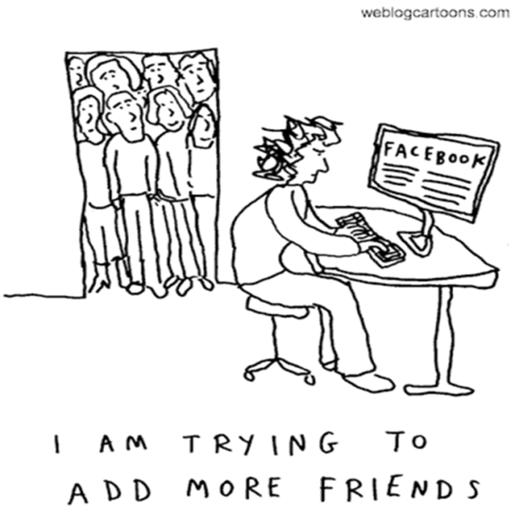
Facebook policy states that businesses run
Fan pages, not Friends pages
Notes:
A Friend page is _________________________________________________________________________________________________________________________________________________________________________________
A Fan page is
_________________________________________________________________________________________________________________________________________________________________________________
All our posts should be made to ___________________________________________________________

Slide 8
Why Fan Pages, not Friend Profiles?
Regional managers will monitor your Fan page
Corporate support teams have administrative access to your Fan page to help with issues
Fan Pages include extra tabs for promotions, events and a floor plan browser coming soon
People have a tendency to “Like” a fan page more than “Become a Friend” of a personal profile
Search engines will include links to Fan pages in search results

Slide 9
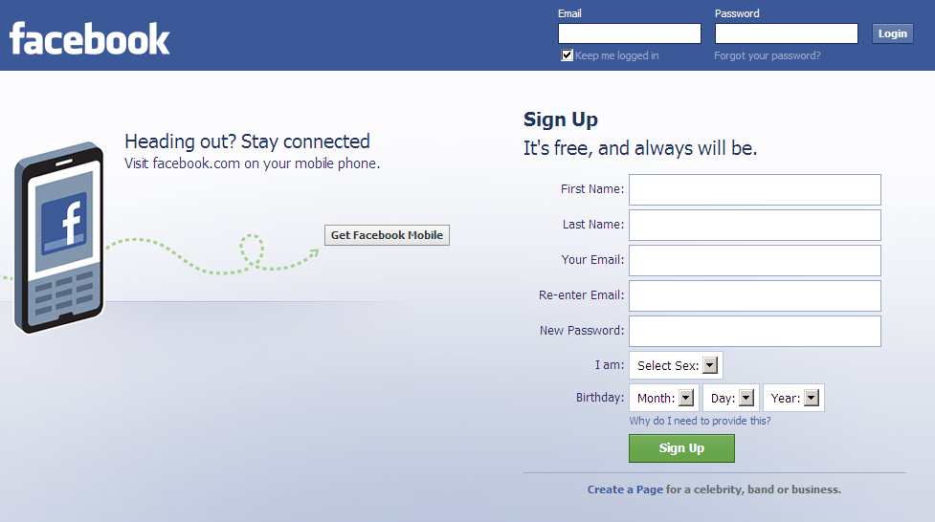
Step 1 – Login to Facebook.com
Notes:
My log in information is
____________________________________________________________________________________________________________________________________________________________________________________________________________________________________________

Slide 10
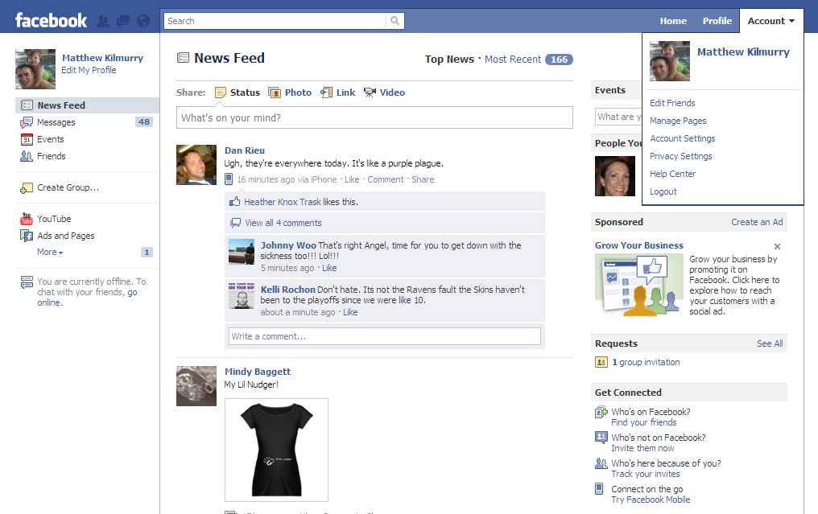
Step 2 – Manage Fan Page
Notes:
Notes:
___________________________________________________________________________________________________________________________________________________________________________________________________________________________________________________________________________________________________________________________________________________________________________________________________________________________________________________________________________________________________________________________________________________

Slide 11
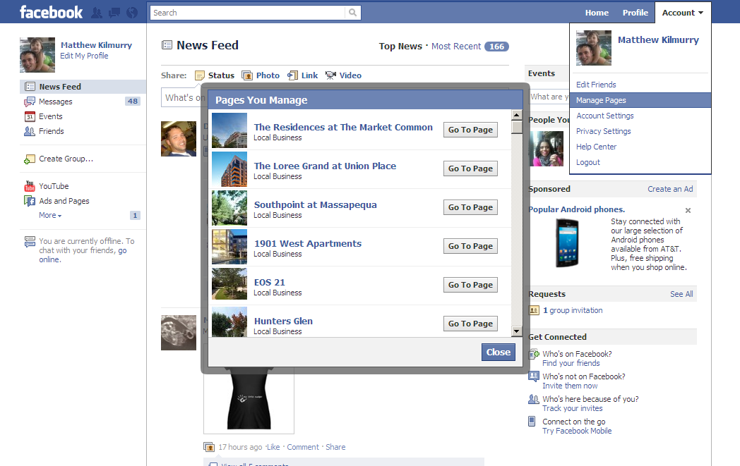
Step 3 – Select Page
Notes:
Notes:
___________________________________________________________________________________________________________________________________________________________________________________________________________________________________________________________________________________________________________________________________________________________________________________________________________________________________________________________________________________________________________________________________________________

Slide 12
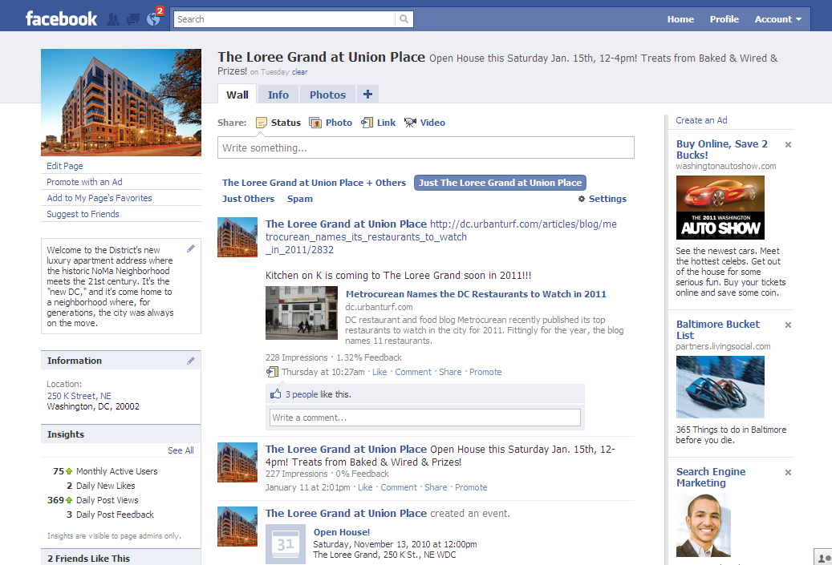
Step 4 – Are You in the Correct Place?
You will see “Edit Page” underneath picture on the Fan Page
Notes:
Notes:
___________________________________________________________________________________________________________________________________________________________________________________________________________________________________________________________________________________________________________________________________________________________________________________________________________________________________________________________________________________________________________________________________________________

Slide 13
How to Update
Use this box to update Fans with posts, photos or links
Notes:
Notes:
___________________________________________________________________________________________________________________________________________________________________________________________________________________________________________________________________________________________________________________________________________________________________________________________________________________________________________________________________________________________________________________________________________________

Slide 14
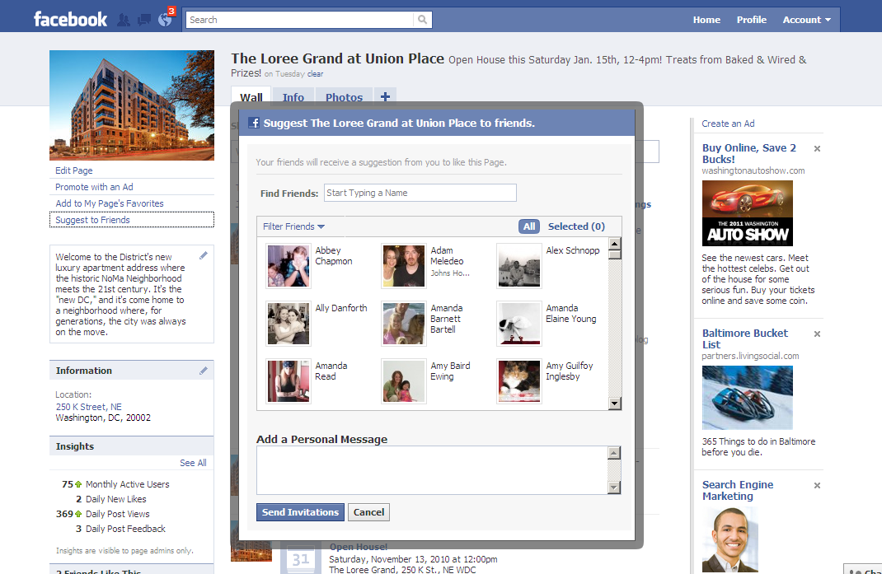
Invite Friends to Become Fans
Click Suggest to Friends
Select Current Friends of your property
Select the Friends you want to invite
Notes:
Notes:
___________________________________________________________________________________________________________________________________________________________________________________________________________________________________________________________________________________________________________________________________________________________________________________________________________________________________________________________________________________________________________________________________________________

Slide 15
Invite Friends to Become Fans
Add a Personal Message
Example:
We have moved! Please Like our new Facebook page to stay up to date on everything at [property name].
Select the Friends you want to invite
Notes:
Notes:
___________________________________________________________________________________________________________________________________________________________________________________________________________________________________________________________________________________________________________________________________________________________________________________________________________________________________________________________________________________________________________________________________________________

Slide 16
How often should I post?
Who and what should I post?

Slide 17
How often should I post?
The Expectation
Post unique fan page content a minimum of 3x per week and maximum of 1x per day
Tired of your same old restaurants? Try 'Woodberry Kitchen'- A Staff Top Pick!
Open House this Saturday Jan. 15th, 12-4pm!
Treats from
Baked & Wired!
Notes:
Notes:
___________________________________________________________________________________________________________________________________________________________________________________________________________________________________________________________________________________________________________________________________________________________________________________________________________________________________________________________________________________________________________________________________________________

Slide 18
Who should post?
All employees are champions of our brand
All front office employees share responsibilities of ensuring Facebook performance
The Property Manager owns scheduling of Brand Champion duties
The Expectation
Notes:
Notes:
___________________________________________________________________________________________________________________________________________________________________________________________________________________________________________________________________________________________________________________________________________________________________________________________________________________________________________________________________________________________________________________________________________________

Slide 19
What should I post?
Events
Photos
Interaction
Self Promotion
Notes:
Notes:
___________________________________________________________________________________________________________________________________________________________________________________________________________________________________________________________________________________________________________________________________________________________________________________________________________________________________________________________________________________________________________________________________________________

Slide 20
Social media guidelines
Don’t post photos of Bozzuto employees with alcohol in hand.
Don’t use slang or profanity in any postings.
Don't delete negative comments until issue or person has been addressed.
Don’t post pricing specials.
Avoid religious terms and links in updates and posts.
Avoid links, updates and posts about social commentary, politics and controversial topics.
Respond to all comments positive and negative.
Don’t post about rent being due.
Notes:
Notes:
___________________________________________________________________________________________________________________________________________________________________________________________________________________________________________________________________________________________________________________________________________________________________________________________________________________________________________________________________________________________________________________________________________________

Slide 21
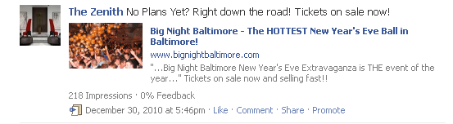

Post local events
Post about local community events…
Use and eye-catching visual…
Notes:
What’s a local event near your property?
_________________________________________________________________________________________________________________________________________________________________________________________________________________________________________________________________________________________________________________________________________________________
Notes:
___________________________________________________________________________________________________________________________________________________________________________________________________________________________________________________________________________________________________________________________________________________________________________________________________________________________________________________________________________________________________________________________________________________

Slide 22
Unique content
Update fans about local events…
Culinary
Education
Entertainment
Health
Non Profits
Professional
Spa
What should I post?
EVENTS
Notes:
Notes:
___________________________________________________________________________________________________________________________________________________________________________________________________________________________________________________________________________________________________________________________________________________________________________________________________________________________________________________________________________________________________________________________________________________

Slide 23
Finding sources for event information demonstration
Delicious.com/Bozzuto: a repository of ideas
What should I post?
EVENTS
Notes:
Notes:
___________________________________________________________________________________________________________________________________________________________________________________________________________________________________________________________________________________________________________________________________________________________________________________________________________________________________________________________________________________________________________________________________________________

Slide 24
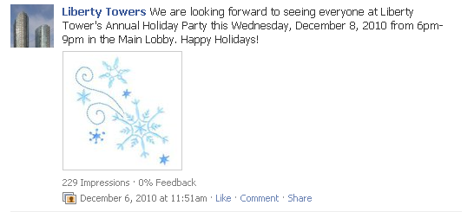
Post property happenings
Update residents about property happenings…
What should I post?
EVENTS
Notes:
What’s going on this week on your property?
_______________________________________________________________________________________________________________________________________________________________________________________________________________________________________________________________________________________________________
Notes:
___________________________________________________________________________________________________________________________________________________________________________________________________________________________________________________________________________________________________________________________________________________________________________________________________________________________________________________________________________________________________________________________________________________

Slide 25
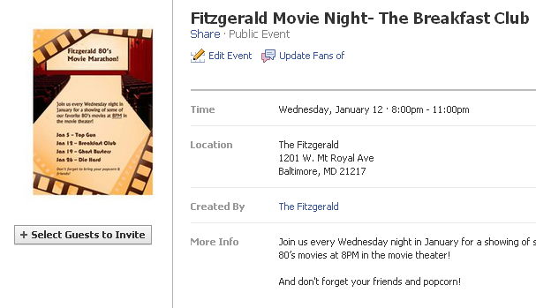
Unique content
Leverage property events…
What should I post?
EVENTS
Notes:
What kind of parties, networking events or happy hours can you host in the next few months?
_________________________________________________________________________________________________________________________________________________________________________________________________________________________________________________________________________________________________________________________________________________________
Notes:
___________________________________________________________________________________________________________________________________________________________________________________________________________________________________________________________________________________________________________________________________________________________________________________________________________________________________________________________________________________________________________________________________________________

Slide 26
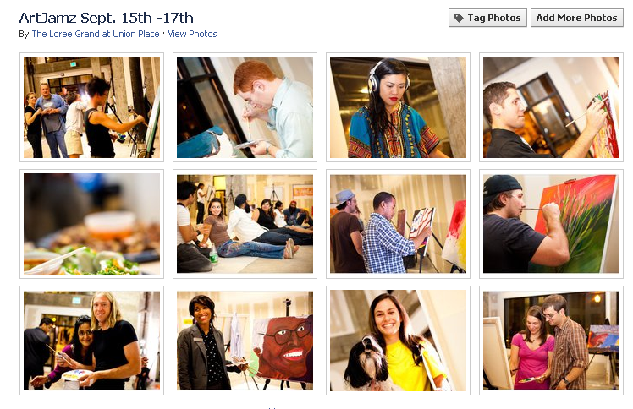
Post photos
Add photos from past events…
What should I post?
PHOTOS
Notes:
Notes:
___________________________________________________________________________________________________________________________________________________________________________________________________________________________________________________________________________________________________________________________________________________________________________________________________________________________________________________________________________________________________________________________________________________

Slide 27
Photo guidelines
Ask residents if it is OK to include their photo on Facebook
Do Not tag residents in photos, rather invite them to tag themselves
Create a new photo album each time, rather than adding new photos to existing albums
What should I post?
PHOTOS
Notes:
Notes:
___________________________________________________________________________________________________________________________________________________________________________________________________________________________________________________________________________________________________________________________________________________________________________________________________________________________________________________________________________________________________________________________________________________

Slide 28
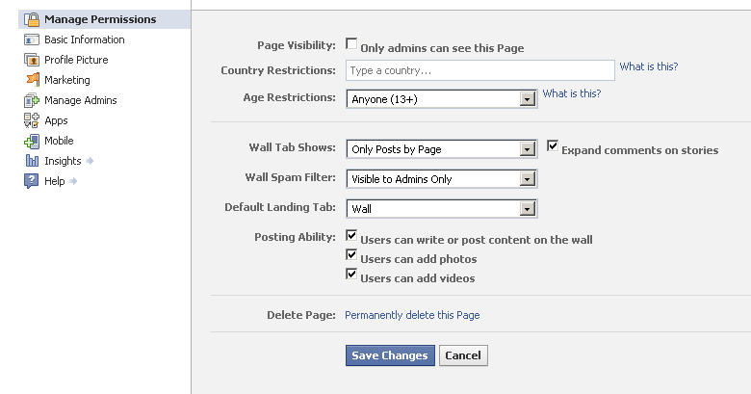
Unique content
Encourage fans to upload their own photos…
Update fan permissions
What should I post?
PHOTOS
Notes:
Notes:
___________________________________________________________________________________________________________________________________________________________________________________________________________________________________________________________________________________________________________________________________________________________________________________________________________________________________________________________________________________________________________________________________________________

Slide 29

Promote interaction
Ask open ended questions to invite others to tell you more than yes or no…
Good Are you going to the parade today?
Better Who is headed to the parade today?
Best Where are you setting up your chair to watch the parade today?
What should I post?
PHOTOS
Notes:
Notes:
___________________________________________________________________________________________________________________________________________________________________________________________________________________________________________________________________________________________________________________________________________________________________________________________________________________________________________________________________________________________________________________________________________________

Slide 30
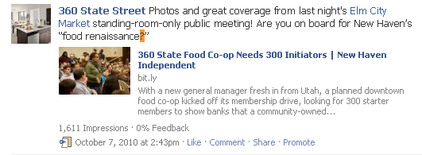
Unique content
Ask questions…
What should I post?
PHOTOS
Notes:
Think of a few questions you could ask related to your property…
_________________________________________________________________________________________________________________________________________________________________________________________________________________________________________________________________________________________________________________________________________________________
Notes:
___________________________________________________________________________________________________________________________________________________________________________________________________________________________________________________________________________________________________________________________________________________________________________________________________________________________________________________________________________________________________________________________________________________

Slide 31
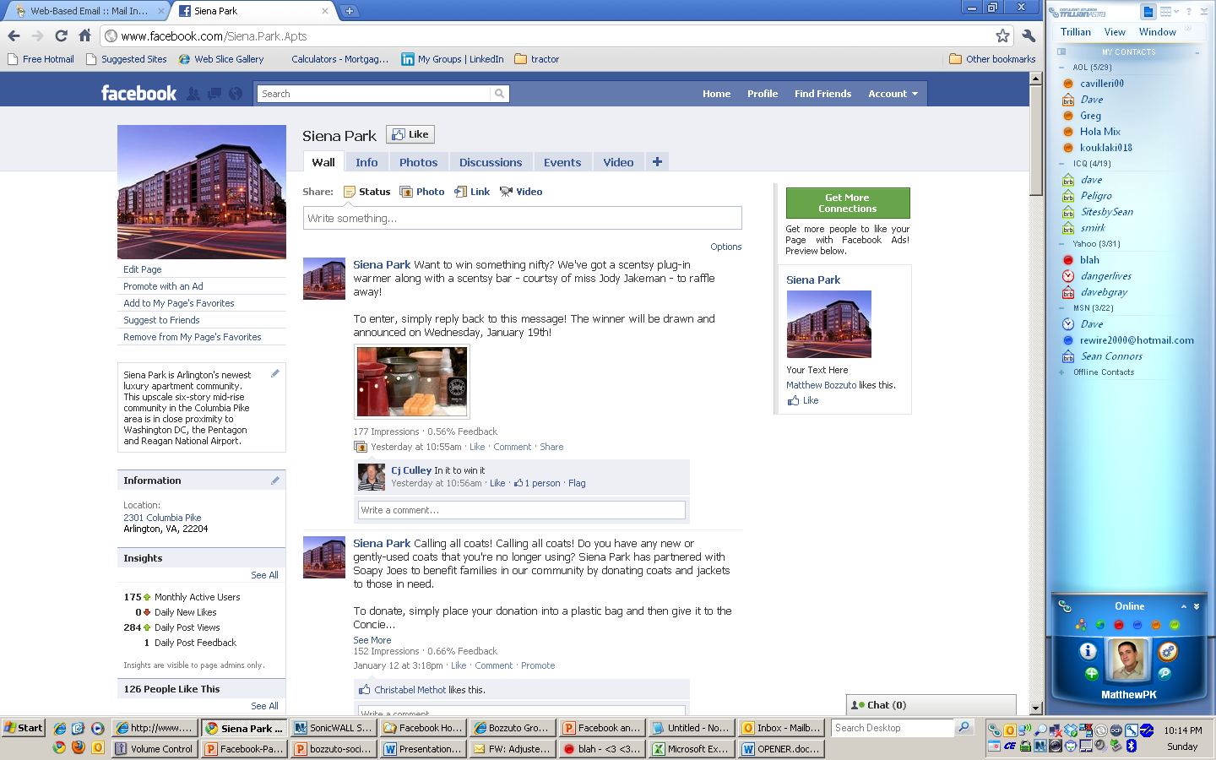
Unique content
Give “Facebook only” privileges, and reward the fans with giveaways or discounts when appropriate
What should I post?
PHOTOS
Notes:
What are some giveaways you have…
_______________________________________________________________________________________________________________________________________________________________________________________________________________________________________________________________________________________________________
Notes:
___________________________________________________________________________________________________________________________________________________________________________________________________________________________________________________________________________________________________________________________________________________________________________________________________________________________________________________________________________________________________________________________________________________

Slide 32

Self promotion
The Expectation
Post no more than 1x per week
We have great one bedroom
homes with breathtaking city views!
What should I post?
PHOTOS
Notes:
Notes:
___________________________________________________________________________________________________________________________________________________________________________________________________________________________________________________________________________________________________________________________________________________________________________________________________________________________________________________________________________________________________________________________________________________

Slide 33
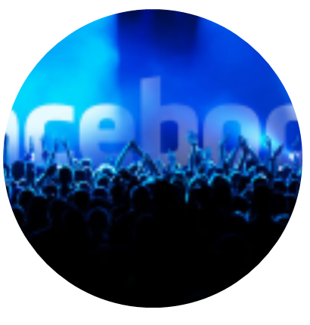
How do I grow my audience?
Ask residents to “LIKE” us
Include your Facebook link in your email signature
Send out quarterly email blasts asking residents to “LIKE” us
Ask current Fans to “Suggest to Friends”
Add other Fan pages to
“favorite pages”
“LIKE” other Fan pages, and tag in updates with @ before the Fan page name
What should I post?
PHOTOS
Notes:
Notes:
___________________________________________________________________________________________________________________________________________________________________________________________________________________________________________________________________________________________________________________________________________________________________________________________________________________________________________________________________________________________________________________________________________________

Slide 34
How do I handle a “hot” post?

Slide 35

How do I handle a “hot” post
With any customer service related post, respond on Facebook with:
“Thank you, we’ll follow-up with you directly” or similar
Follow up with resident directly via phone or email to address the
issue
2. Hold off on updating the profiles until the resident issue has been
addressed
3. On the property Facebook fan page, DO NOT delete the negative
wall posts or comments unless directed to by Lauren
4. Be careful of your language when responding, people are watching
the conversation
Notes:
Notes:
___________________________________________________________________________________________________________________________________________________________________________________________________________________________________________________________________________________________________________________________________________________________________________________________________________________________________________________________________________________________________________________________________________________

Slide 36
How do I handle a “hot” post
Escalate a post to your regional manager or Lauren when:
Derogatory, profane, abusive, obscene or malicious comments
Harassments/Threats
Content that calls out employee(s) by name
If there is an unwarranted negative or spam post, contact Lauren
directly
Notes:
Notes:
___________________________________________________________________________________________________________________________________________________________________________________________________________________________________________________________________________________________________________________________________________________________________________________________________________________________________________________________________________________________________________________________________________________

Slide 37
Final considerations
DO this…
Introduce value, insight and direction with each engagement.
KISS (Keep It Short & Simple).
Focusing on the quality of fans.
If someone comments on your fan page, reply with an answer or a "thank you."
…DON’T do this
Speaking to audience through canned messages.
Long, wordy posts or responses to comments.
Focusing on the quantity fans.
Waiting too long to answer a comment on the fan page
Notes:
Notes:
___________________________________________________________________________________________________________________________________________________________________________________________________________________________________________________________________________________________________________________________________________________________________________________________________________________________________________________________________________________________________________________________________________________

Slide 38


Slide 39
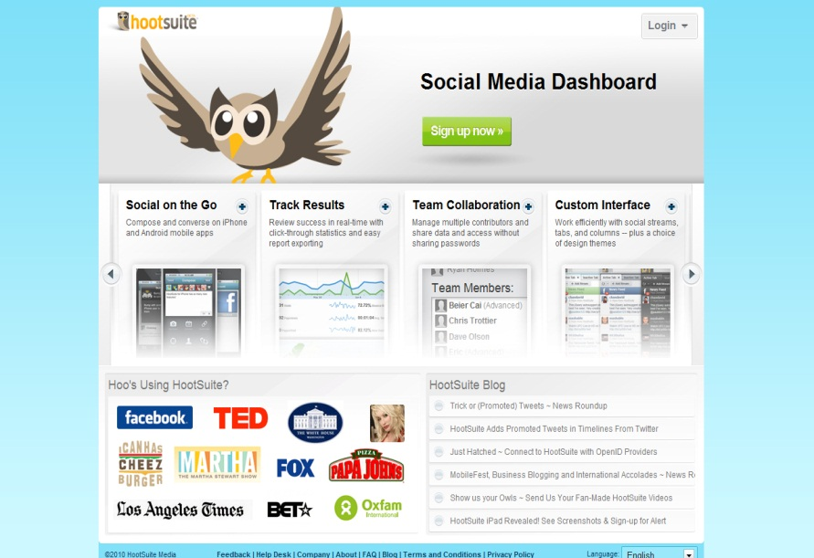
What is HootSuite?
HootSuite is software
that helps manage a Facebook page
and saves YOU time.
Notes:
Notes:
___________________________________________________________________________________________________________________________________________________________________________________________________________________________________________________________________________________________________________________________________________________________________________________________________________________________________________________________________________________________________________________________________________________

Slide 40
More specifically…
Compose status updates
Ensures the correct Fan page is being updated
You can schedule status updates for the future
Management can review all activity at one time
Monitor any posts or comments from fans
Includes team work flow for Regional Manager or Lauren
Manage OTG with an app for iPhone, iPad or Blackberry
Respond to comments from fans
Notes:
Notes:
___________________________________________________________________________________________________________________________________________________________________________________________________________________________________________________________________________________________________________________________________________________________________________________________________________________________________________________________________________________________________________________________________________________

Slide 41
How do I use HootSuite? demonstration

Slide 42


Conclusion
Posting
Scheduling
Monitoring
Responding to Comments
Uploading Pictures
Creating Events
“Liking” other local businesses
You will still need to login into Facebook
Notes:
Notes:
___________________________________________________________________________________________________________________________________________________________________________________________________________________________________________________________________________________________________________________________________________________________________________________________________________________________________________________________________________________________________________________________________________________

Slide 43
How will my property be measured on our performance?

Slide 44

How will my property be measured on our performance?
Each quarter as part of the property
inspection report, the following items will
be evaluated & scored:
Monthly post views
Monthly post feedback
Total number of albums
Total number of Facebook
fans
Goal
To continually improve performance quarter over quarter
Notes:
Notes:
___________________________________________________________________________________________________________________________________________________________________________________________________________________________________________________________________________________________________________________________________________________________________________________________________________________________________________________________________________________________________________________________________________________

Slide 45
Thank you & Next steps
Notes:
Notes:
___________________________________________________________________________________________________________________________________________________________________________________________________________________________________________________________________________________________________________________________________________________________________________________________________________________________________________________________________________________________________________________________________________________

