Slide 1
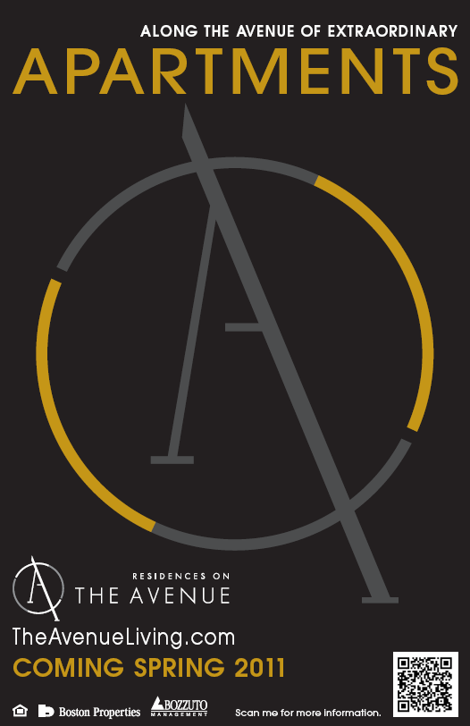

Slide 2
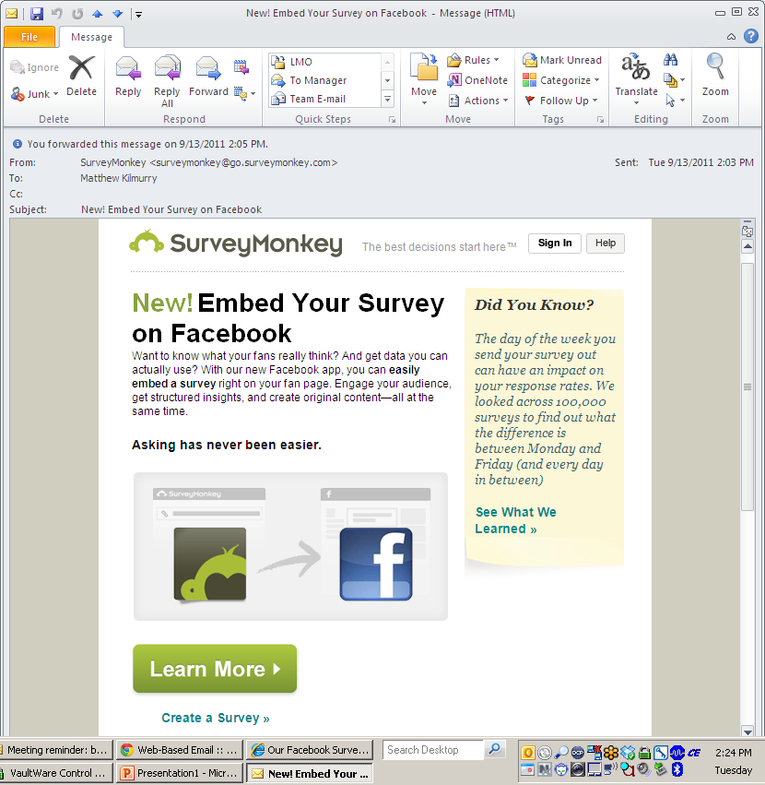
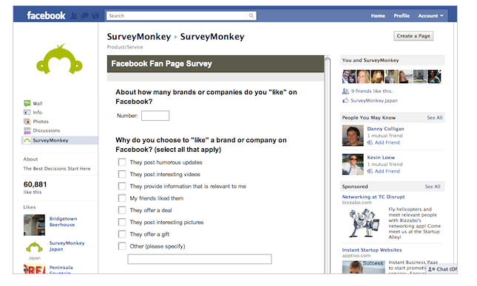

Slide 3
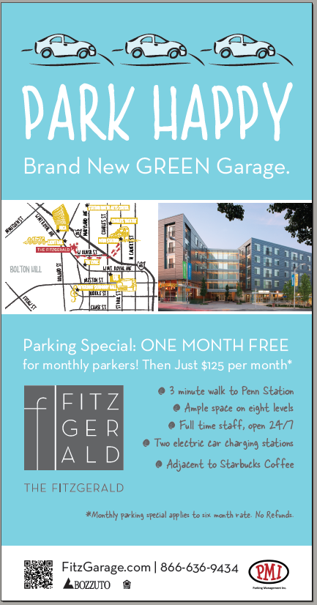

Slide 4



Slide 5
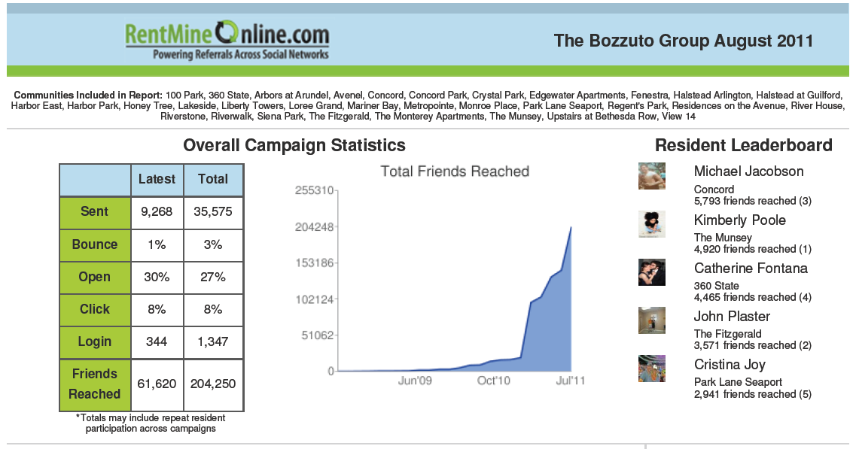

Slide 6
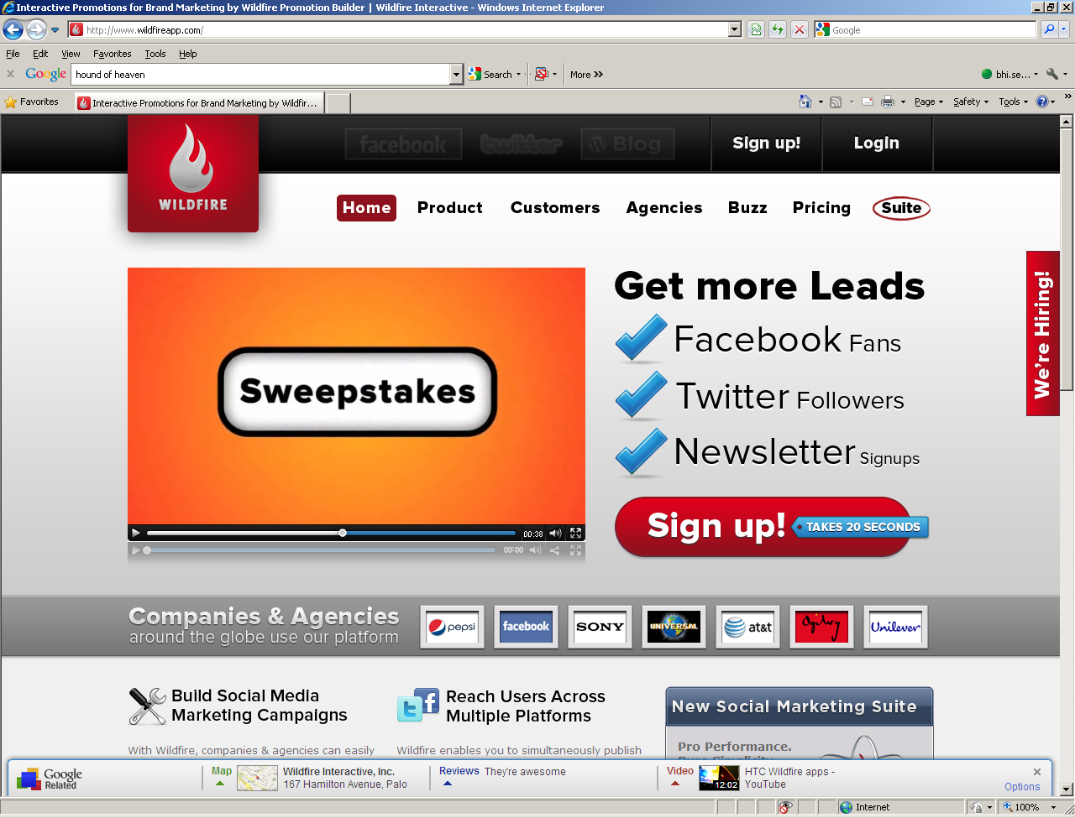
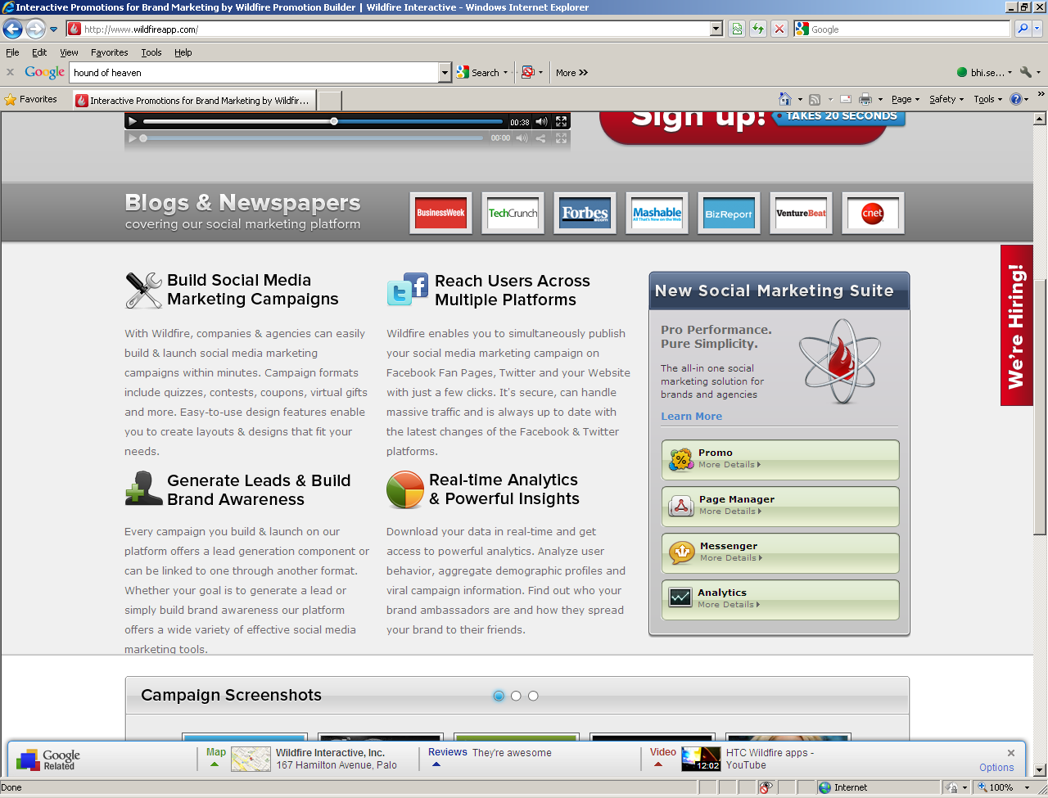

Slide 7
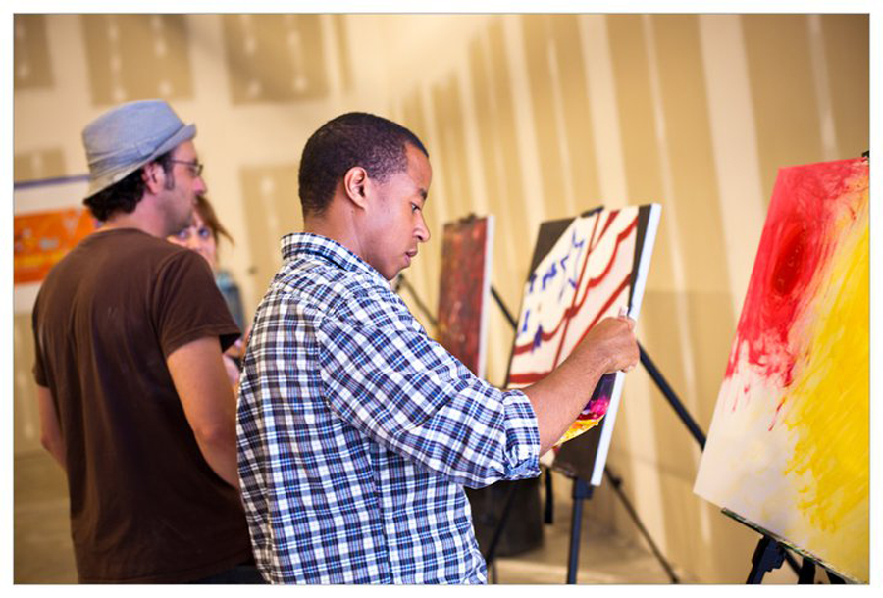
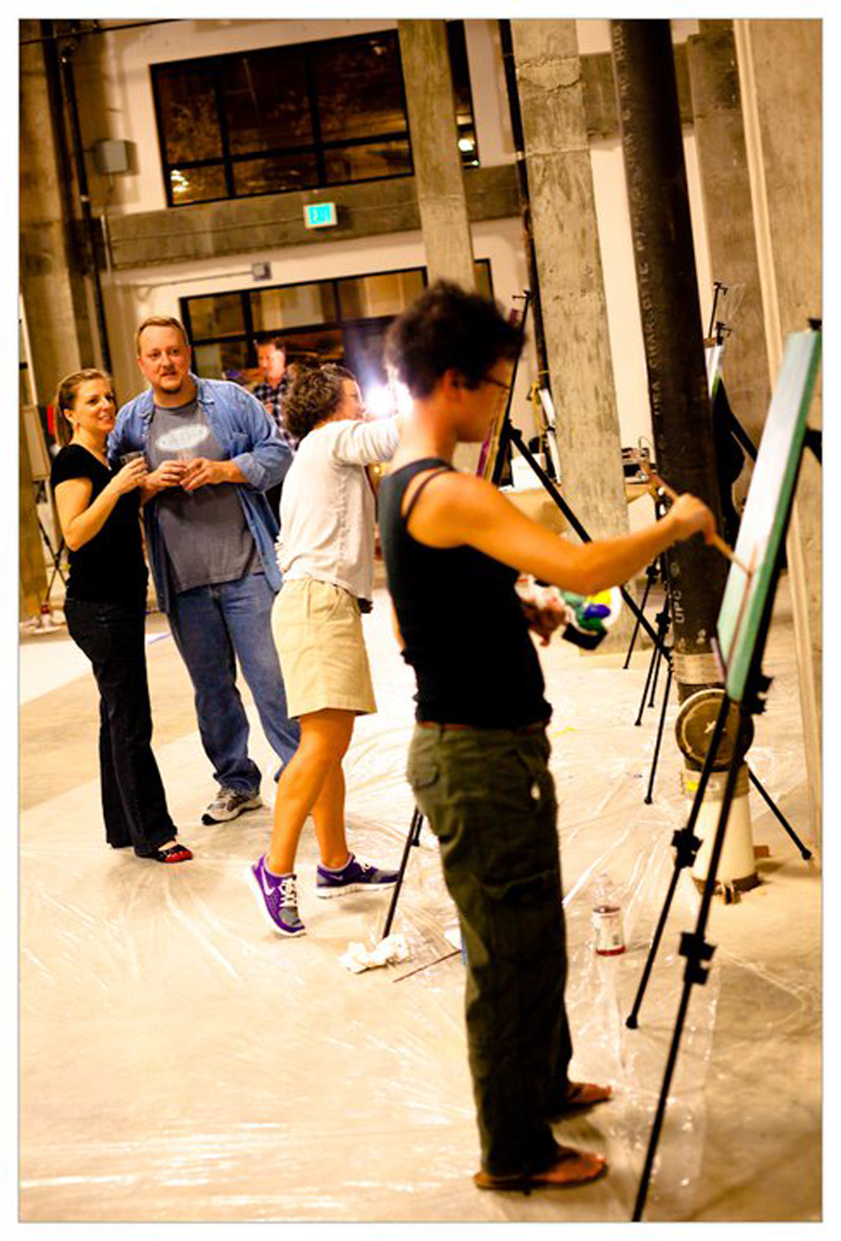

Slide 8
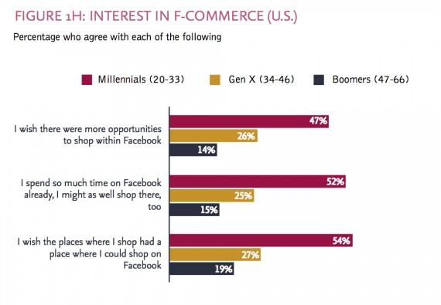
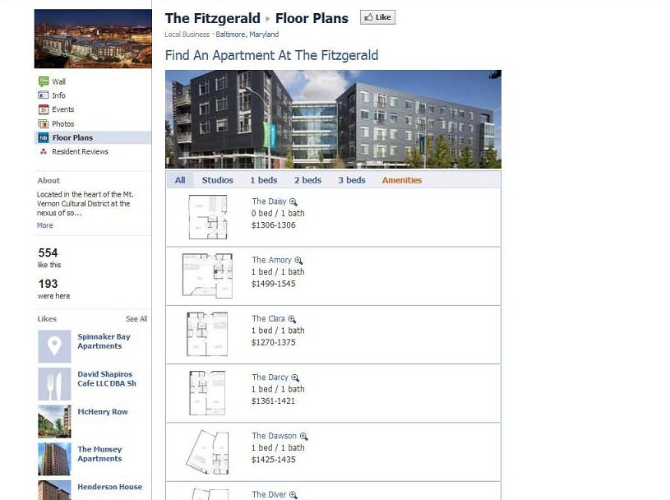

Slide 9


Bozzuto Sweeps: What’s Your “Insider Secret?”
Purpose:
Launch a sweepstakes in 5 major cities. Promote the city as a destination – expressing that we have a great presence with great apartment communities.
Goals:
Generate leads and capture email addresses (increase penetration into each property)
Increase Fans and Followers in social media
Ways to Enter:
Enter your email address on the Live Bozzuto Facebook page or on BozzutoSweeps.com.
Comment on Facebook, Twitter, write a blog post or upload a video on YouTube.

Slide 10

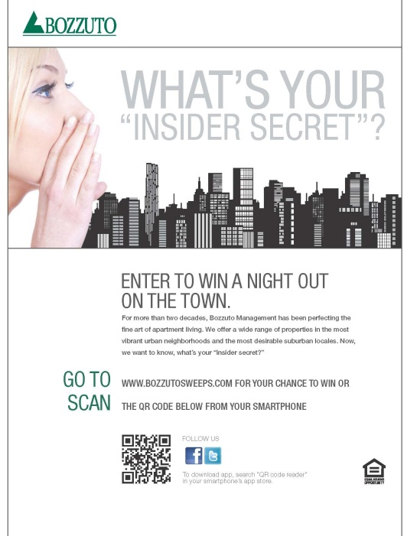
Bozzuto Sweeps: What’s Your “Insider Secret?”
One Frame of a Flash Banner Ad Flyers distributed to
the properties

Slide 11
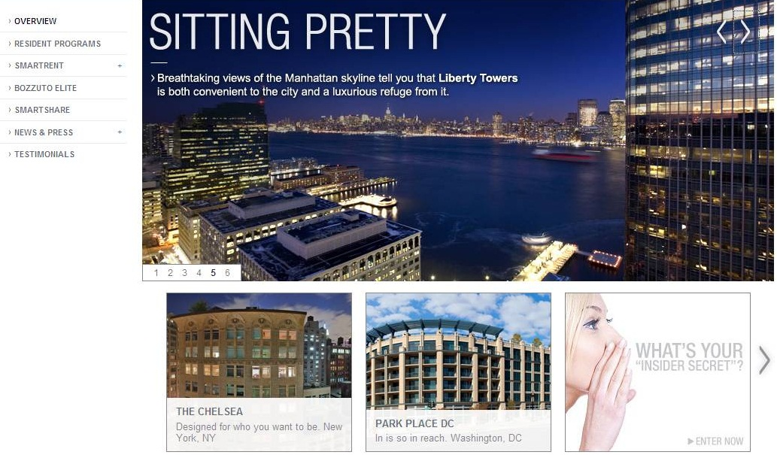
Bozzuto Sweeps: What’s Your “Insider Secret?”
Custom Landing Page
A feature on the carousel on Bozzuto.com:

Slide 12
Bozzuto Sweeps: What’s Your “Insider Secret?”
Results to Date for Baltimore
Phone leads: 50
Website visitors: 1,500
Email entries: 317
Residents: 190
Non-residents: 127
Facebook:
Gained over 200 fans
Number of posts: 18
Twitter:
Gained almost 50 followers
Number of tweets: 18

Slide 13
QR Codes
What they are
Who is using them
Where to find resources

Slide 14


Slide 15
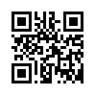
QR Codes Defined
What are QR codes?
A QR (Quick Response) code is a 2d barcode containing a hidden message, which is unlocked by using an application on one’s smartphone.
Notes:
http://mghus.com/blog/2011/03/18/an-intro-to-qr-codes/
http://mghus.com/qr-code-survey-results

Slide 16
QR Codes Defined
Here’s how they work the real world:
1. John Smith spots a QR code on a window cling of a restaurant.
2. He pulls out his smartphone (iPhone, Android, Blackberry) and opens (or downloads) a QR code reader application.
3. He holds his phone over the QR code, and the phone’s camera recognizes the symbol as a QR code.
4. The application then “reads” the QR code, and provides him with some type of content for his mobile phone.

Slide 17
QR Codes Defined
Through QR code technology, marketers are able to directly connect consumers with websites and interactive content via real-world locations.
But is the technology gaining popularity with consumers?

Slide 18
QR Codes Defined
According to a new survey by advertising agency MGH:
72 percent of smartphone users were likely to recall an advertisement that featured a QR code.
32 percent of smartphone users surveyed said they've used a QR code, a much higher percentage than other previous surveys of QR usage.
More striking, the vast majority – 70 percent – of respondents said they plan to use a QR code, creating opportunities for marketers to get consumers to engage directly with their brands.

Slide 19
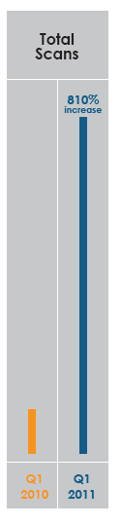
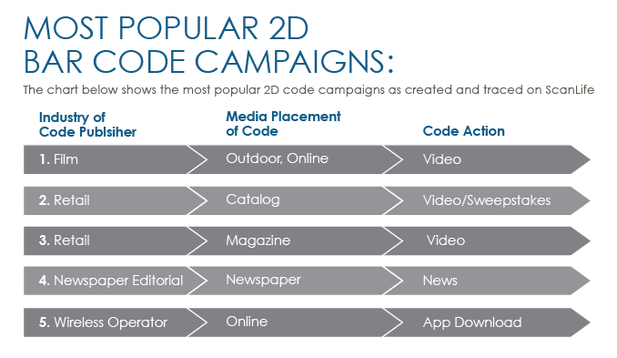
QR Code Statistics

Slide 20
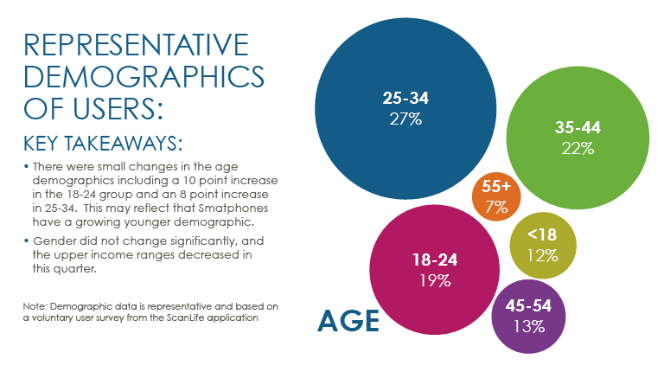
QR Code Statistics
Scan Life QR Code whitepaper stats
Scan LIfe capabilities and cost
Free QR Code generators
Custom QR Codes (software)
Demonstrate creating a QR Code
Providing unique content
Examples in the industry
ShareSquare
Videos (mobile devices challenge)
Near field communication

Slide 21
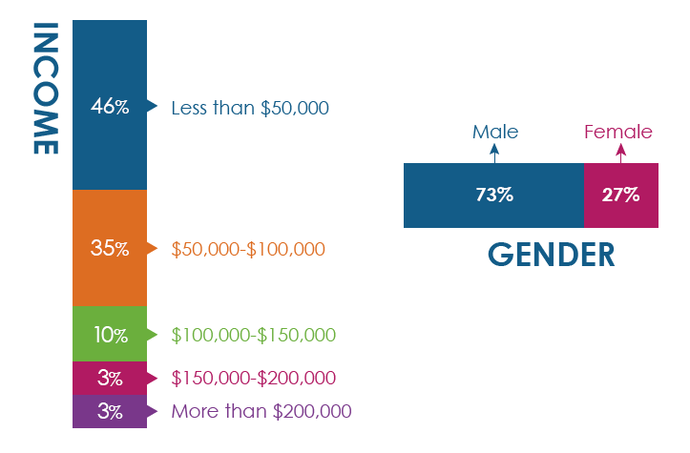
QR Code Statistics
Scan Life QR Code whitepaper stats
Scan LIfe capabilities and cost
Free QR Code generators
Custom QR Codes (software)
Demonstrate creating a QR Code
Providing unique content
Examples in the industry
ShareSquare
Videos (mobile devices challenge)
Near field communication

Slide 22
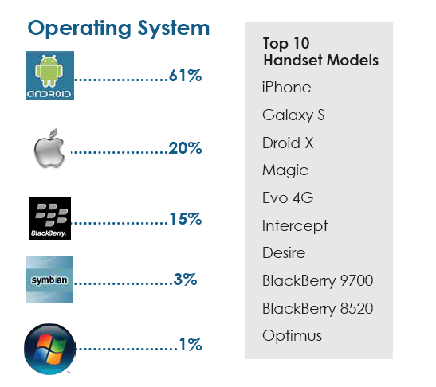

Slide 23
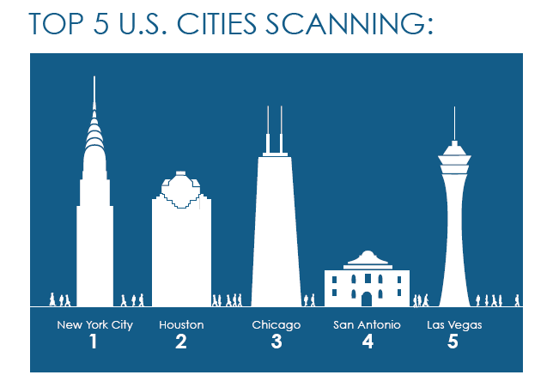

Slide 24
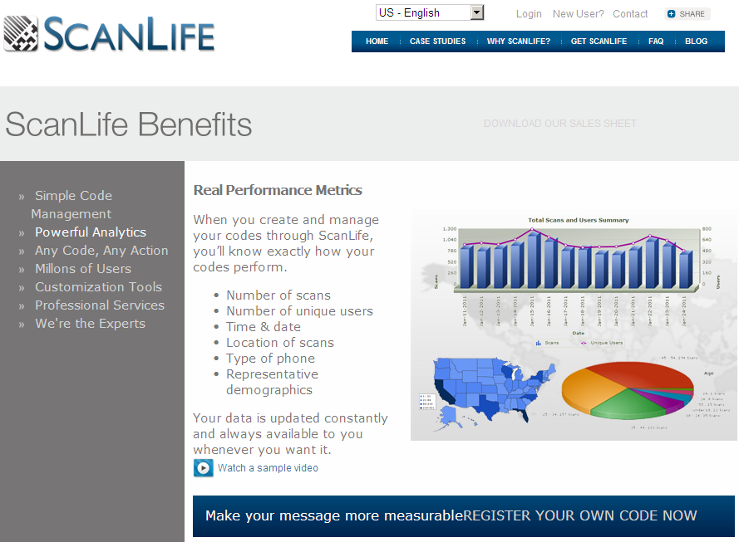

Slide 25
Home Depot Builds Mobile with ScanLife
The Home Depot is taking a very strategic approach QR technology which speaks to their customers in relevant ways throughout the shopping experience.
QR codes will link to How-To videos, project guides, accessories, and an option to purchase through the mobile device.
The first campaign will be around the Martha Stewart line of kitchen appliances and patio furniture buying.

Slide 26
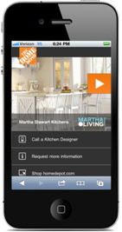
Home Depot Builds Mobile with ScanLife

Slide 27
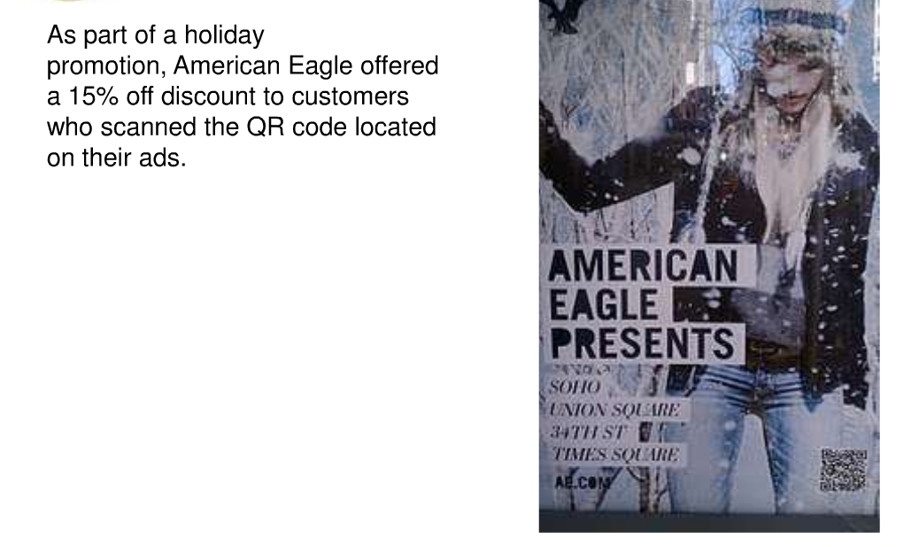

Slide 28
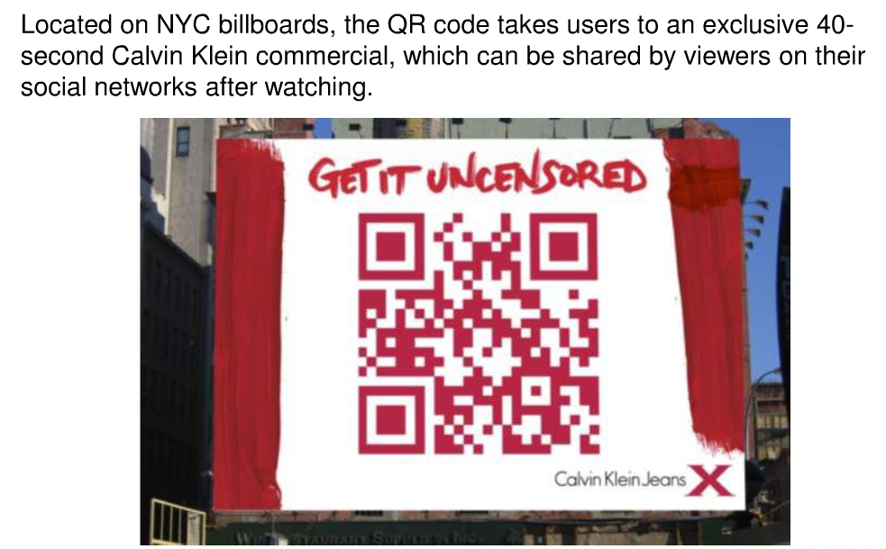
Providing unique content
STOP – do not send people to the homepage of your website

Slide 29
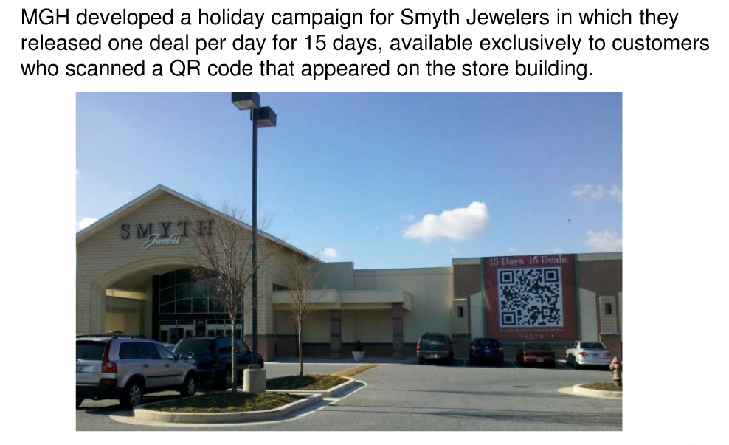
Providing unique content
STOP – do not send people to the homepage of your website

Slide 30
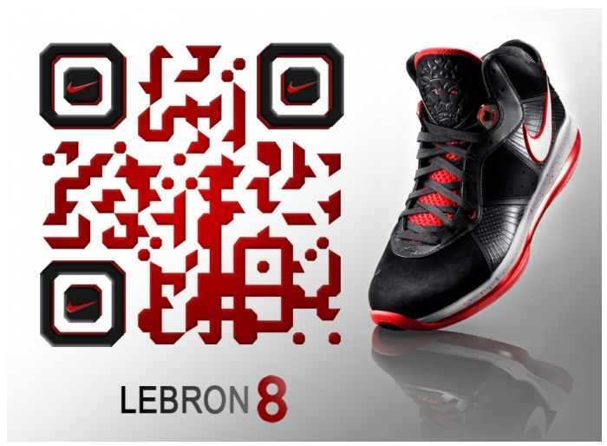
Custom QR Codes

Slide 31
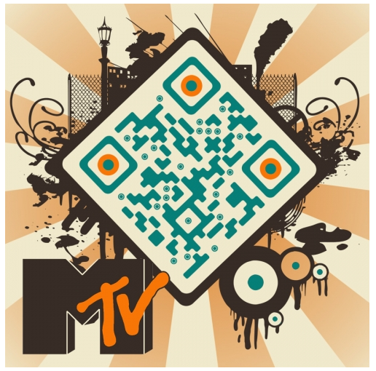
Custom QR Codes

Slide 32
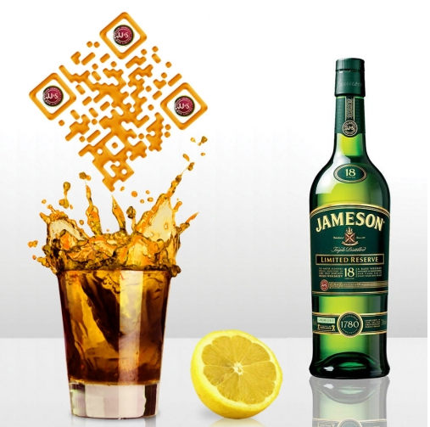
Custom QR Codes

Slide 33
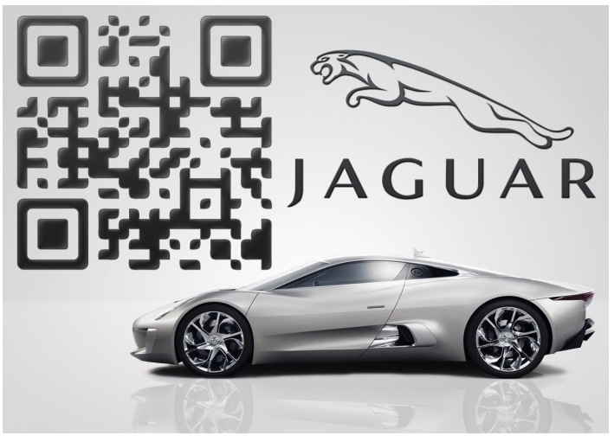
Custom QR Codes

Slide 34
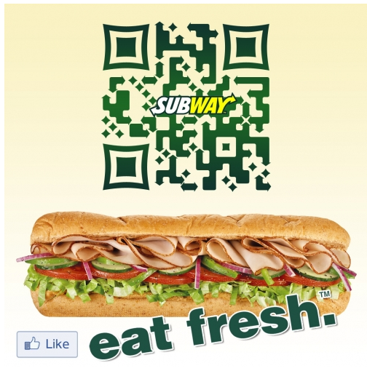
Custom QR Codes

Slide 35
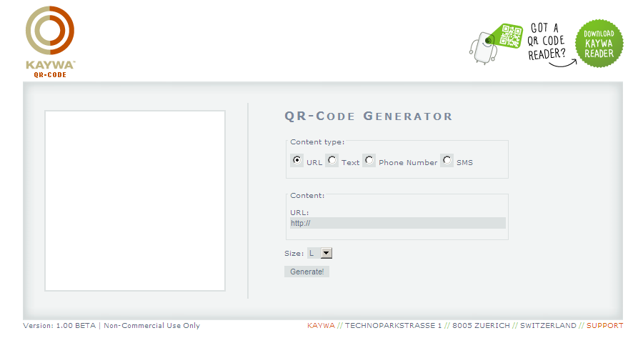
Generate Your Own QR Codes

Slide 36
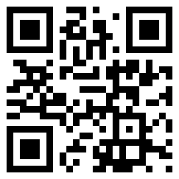

Slide 37
Provide Unique Content
STOP – Do not send people to the homepage of your website

Slide 38
Additional Functions to QR Codes
Bookmark a website
Make a phone call
Send an SMS text
Send an E-Mail
Create a vCard
Create a vCalendar Event
Google Maps
Bing Maps
Download App in iTunes or Android Marketplace
Foursquare Check-In
Tweet on Twitter
Do a Google search for ‘Kerem Erkan’

Slide 39
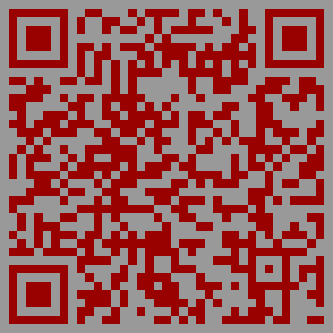

Slide 40
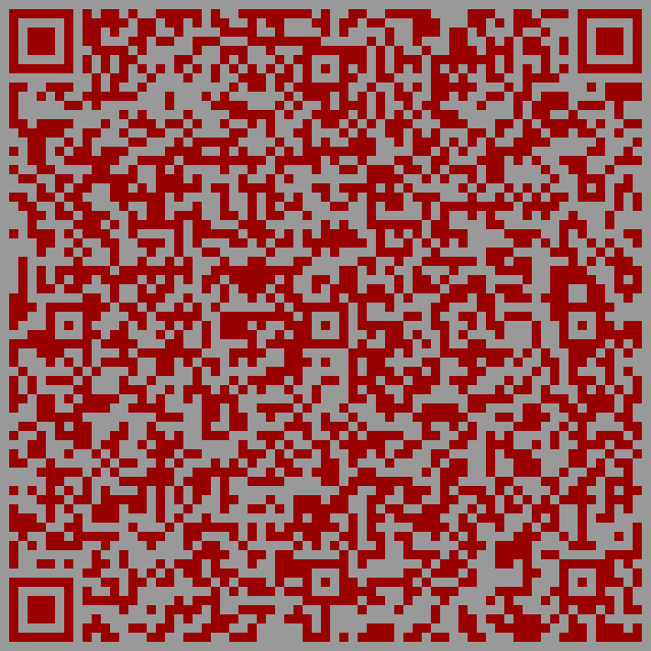

Slide 41
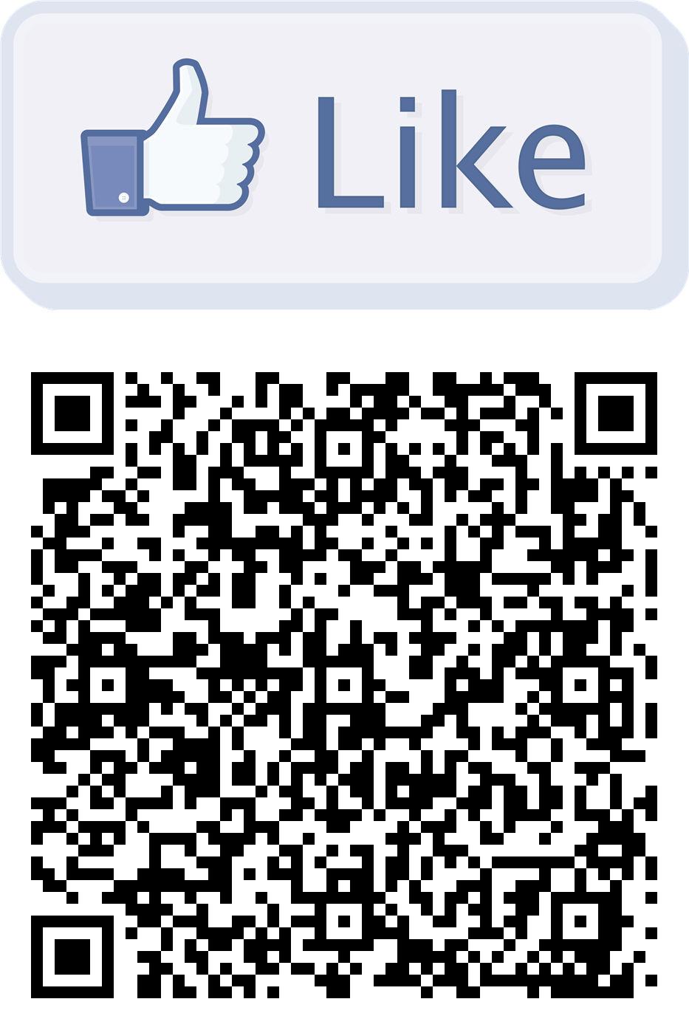

Slide 42
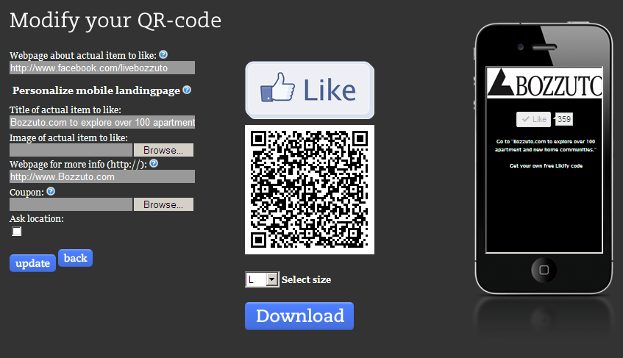

Slide 43
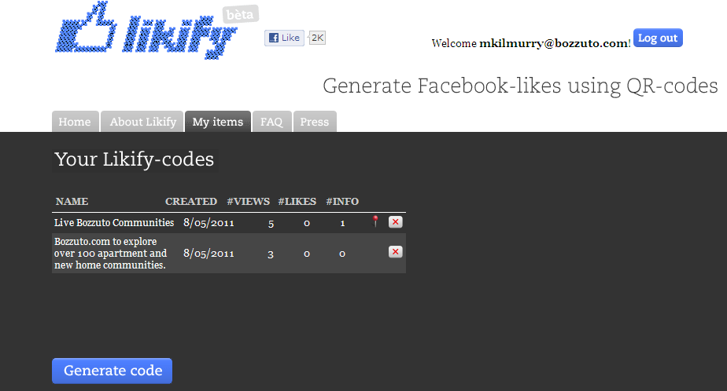

Slide 44

ShareSquare

Slide 45
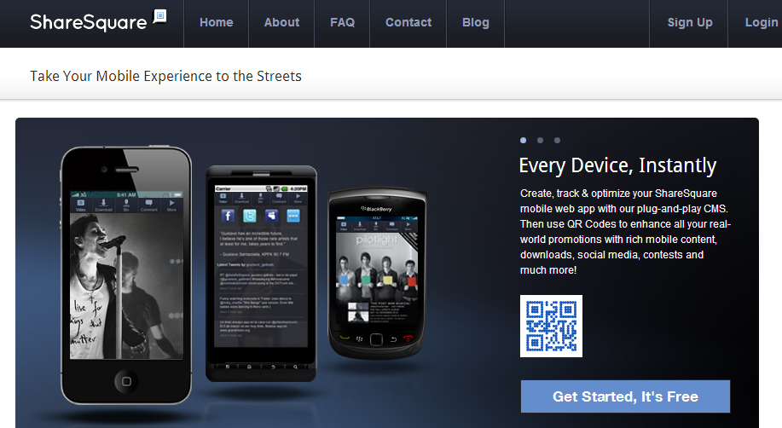
ShareSquare

Slide 46
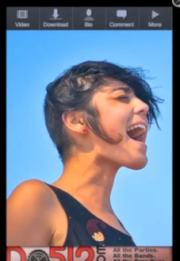
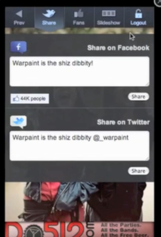
ShareSquare

Slide 47
ShareSquare
What it does: the QR code will lead to a landing page with a (up to) 5 picture slideshow running. At the top the following links are available:
Video: add a youtube video
Download: iTunes, iPhone App, Android Market App, or draft an email that the mobile user can have sent to themselves (this also gives us a record of their email address).
Bio: gives a short bio, links to Facebook Page, Twitter (will show a stream of recent tweets), website, and blog.
Fans: like Facebook FanPage
Share: Provide a status update for the user to post on their Facebook or Twitter.

Slide 48
ShareSquare
Instant Win: Can create giveaways. Enter in start and end date. Winners determined by a daily limit and a maximum number of winners. You can also attach a picture, a winner and loser message, and a Facebook status update for the winner. (Uses Facebook authentication with the winners—winners have to submit their email to be contacted for the prize)
Comments: users can post comments
Other settings:
“Like Lock” the page so that visitors have to like your facebook page before they can access the page.
Custom domain for the page.
Can redirect them to this page from another website.
Can place a banner ad on the page.

Slide 49
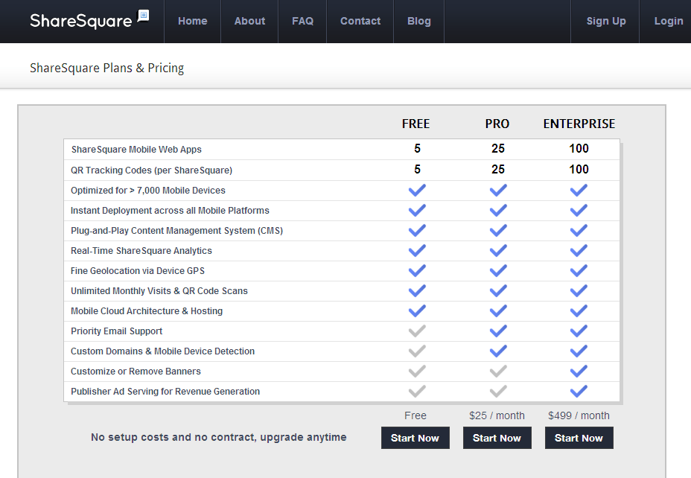

Slide 50
