Slide 1
Resolving Data Controversies
Matthew Kilmurry
Director of Interactive Marketing
The Bozzuto Group

Slide 2
Let’s Start Downstream

Slide 3





Property Management Systems
Rent Rolls and Pricing

Slide 4



Customer Relationship Management (CRM)
Prospect Tracking and Data Extension

Slide 5






Content Management Systems
Corporate and Property Websites

Slide 6







Internet Listing Services

Slide 7

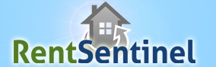



Logo Overload

Slide 8
Customer relationship management (CRM) is a strategy for managing a company’s interactions with customers, clients and sales prospects. It involves using technology to organize, automate, and synchronize business processes — principally sales activities.

Slide 9
Insight Into Bozzuto Lead Generation
Rank | Portfolio: | Average leads per property 2010
1 (1) | Bozzuto | 275.02 (263)
2 | Portfolio A | 267.14
3 | Portfolio B | 175.47
** | Average | 137.60 (123)
4 | Portfolio C | 118.40
5 | Portfolio D | 115.12
6 | Portfolio E | 110.88
7 | Portfolio F | 98.18
8 | Portfolio G | 97.95
9 | Portfolio H | 51.89

Slide 10
Percentage of Lead Type
Lead2Lease Portfolio
Bozzuto Portfolio

Slide 11
Conversion Rates by Contact Type
* Data from 192,535 inquiries through Lead2Lease during the 3rd quarter 2010

Slide 12
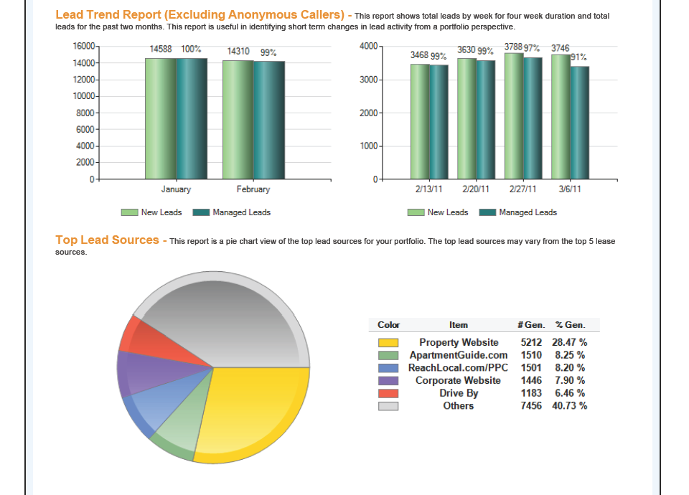
Matthew Kilmurry

Slide 13
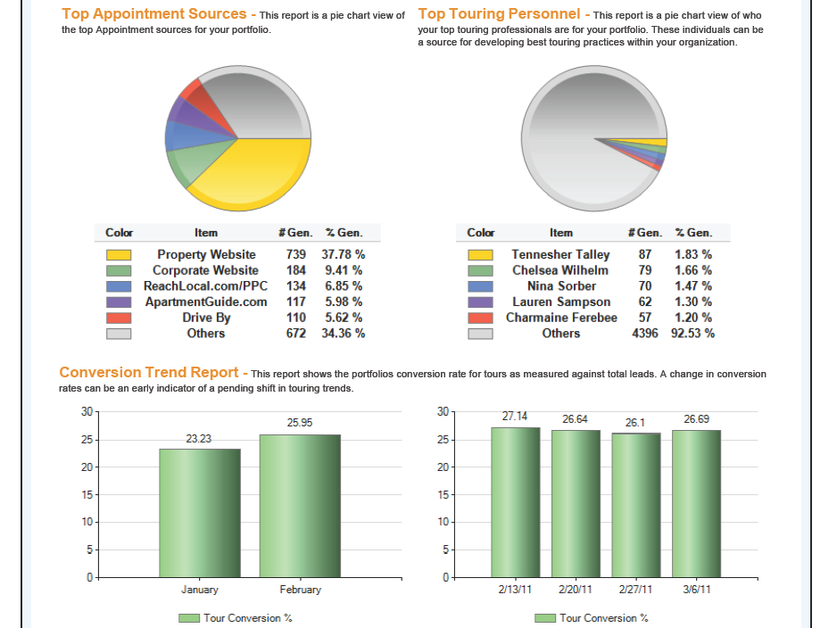
Matthew Kilmurry

Slide 14
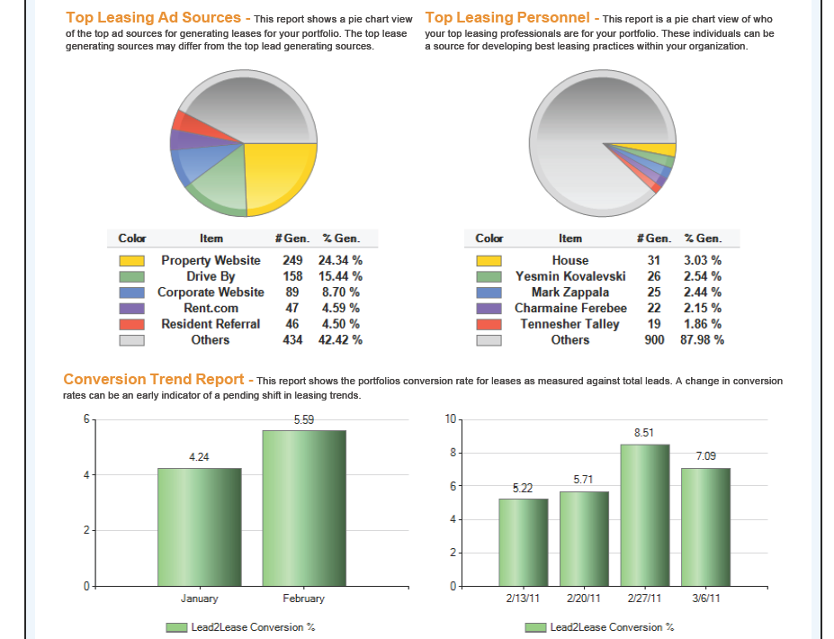
Matthew Kilmurry

Slide 15
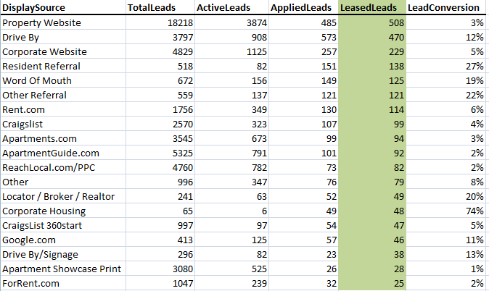
Unpacking the Data

Slide 16
A CRM System is NOT an Ad Tracking System

Slide 17

Swimming Upstream

Slide 18





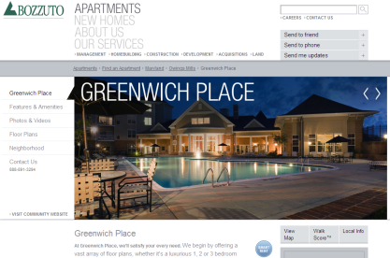
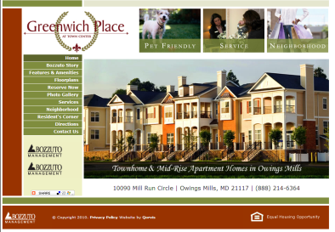
Typical Behavior During Research
Searching
Internet Listing Services
Social Media
Property Website
Bozzuto.com
Notes:
Prospects will typically find your site through multiple sources prior to contact.

Slide 19
Sourcing Online Leads
Phone Call
Contact Form
Reservation (VaultWare)

Slide 20
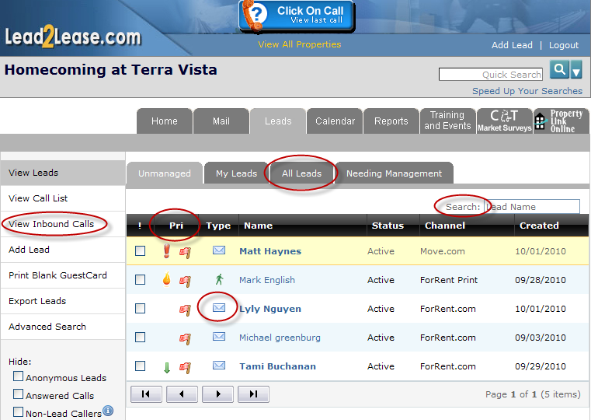
Inbound Calls Create New Guestcards
Matthew Kilmurry

Slide 21
Dynamic Number Rewrite

Slide 22
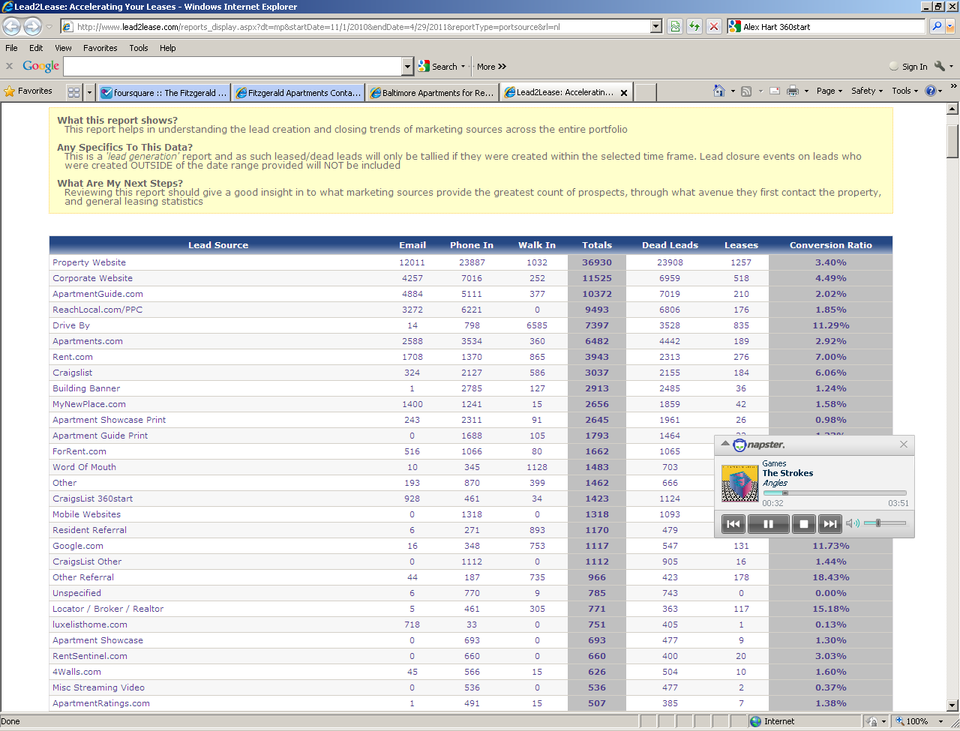
Reducing General Website Category
Apartment Ratings (11.1.10-4.29.11)
Phone Leads: 491
Walk In: 15
Email: 1
Leases: 7
Conversion Ratio: 1.38%

Slide 23




Tracking Contact Form Submissions
Reservation
Contact Us Form (Bozzuto.com and Property Website)
Ad Tracking Solutions

Slide 24

Click Thru Versus View Thru
Impressions: 1,021,385
Clicks: 2,894
Click Thru Leads: 145
Conversion Rate: 5%
View Thru Leads: 474
Percent View Thru: 75%
Total Leads: 619
Conversion Rate: 21%

Slide 25

Click Thru Versus View Thru
Impressions: 2,162,284
Clicks: 4,097
Click Thru Leads: 146
Conversion Rate: 3.5%
View Thru Leads: 621
Percent View Thru: 80%
Total Leads: 767
Conversion Rate: 19%

Slide 26

Installing Tracking Pixels on Listing Pages

Slide 27
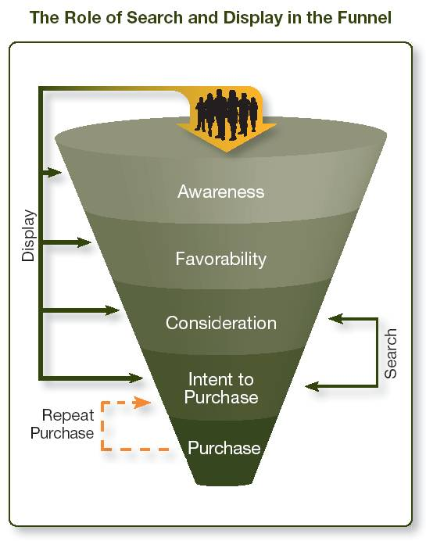
Multi-Touch Attribution Conversion Tracking

Slide 28
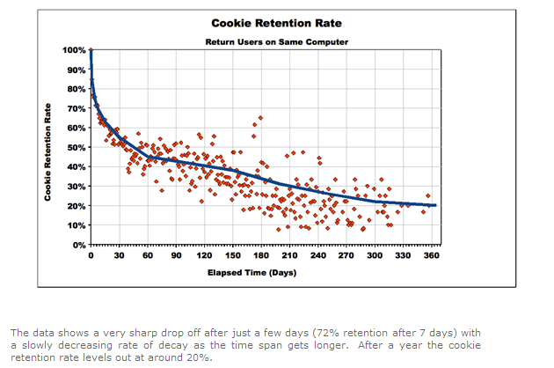
Cookie Retention Rate

Slide 29
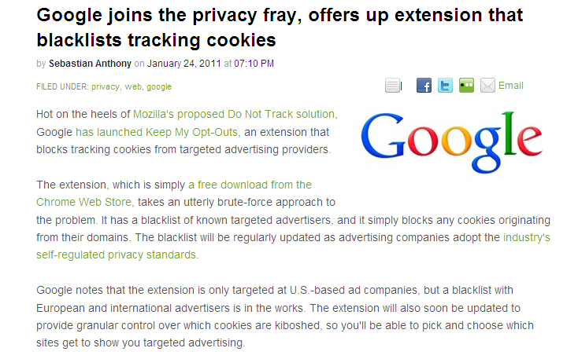
Privacy Fears

Slide 30
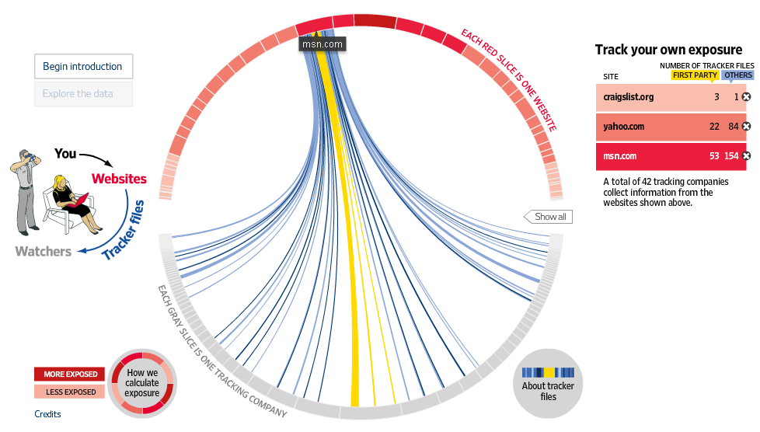
Cookies Are Everywhere

Slide 31
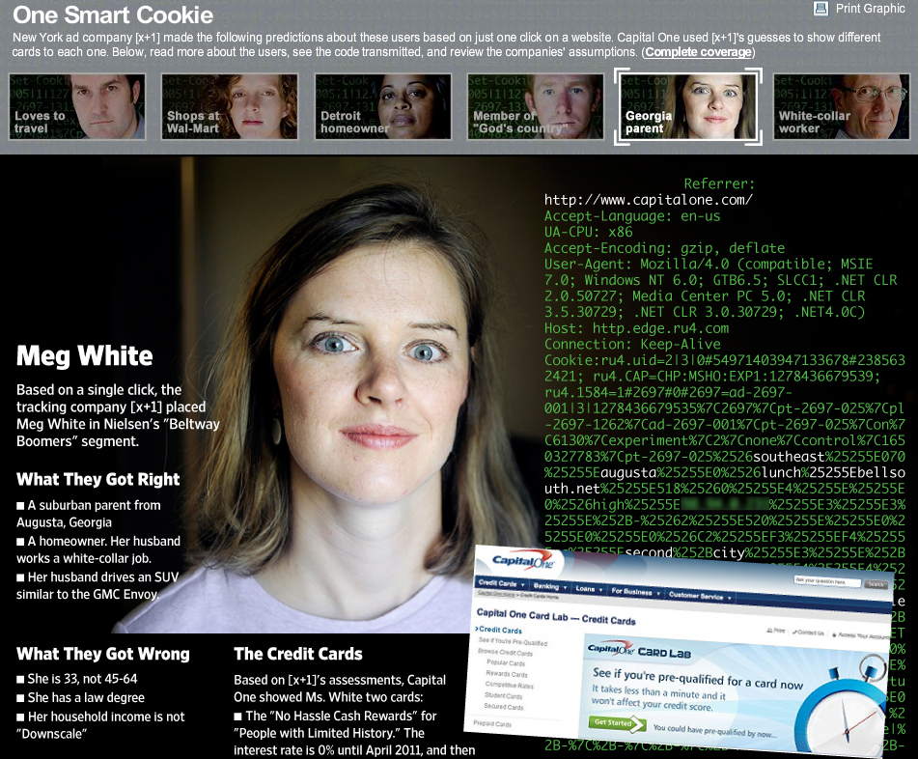
Resolving Data Controversies

Slide 32
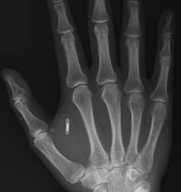
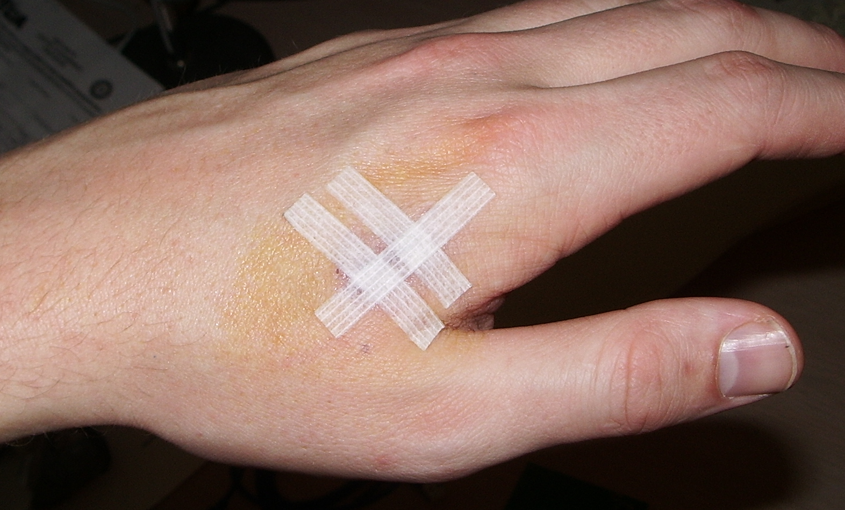

How To Track Walk-Ins? RFID Chips Are The Future
Minimally Invasive
Scars Mostly Heal

Slide 33

Matthew
Kilmurry.net
@MKilmurry
LinkedIn.com/In/MKilmurry

