Slide 1
Mobile Websites

Slide 2
http://www.youtube.com/watch?feature=player_detailpage&v=5bHVGev9UCU

Slide 3
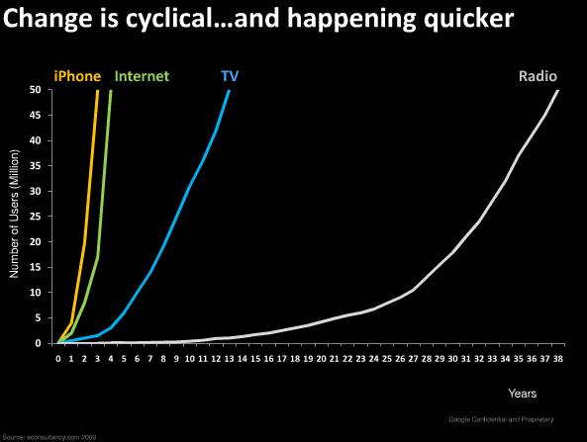

Slide 4
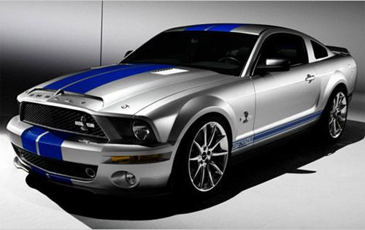
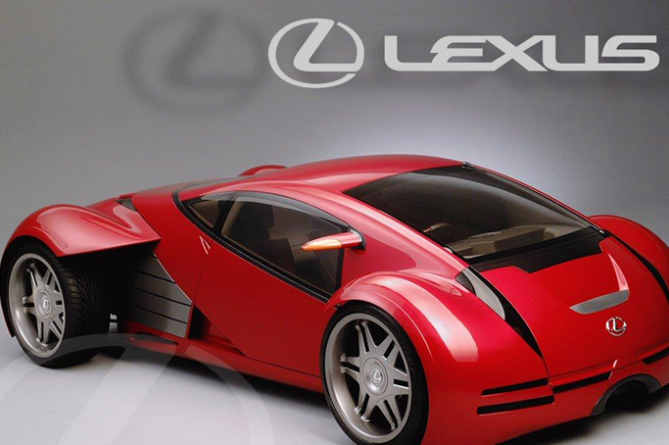
Mobile Friendly Websites
VS

Slide 5
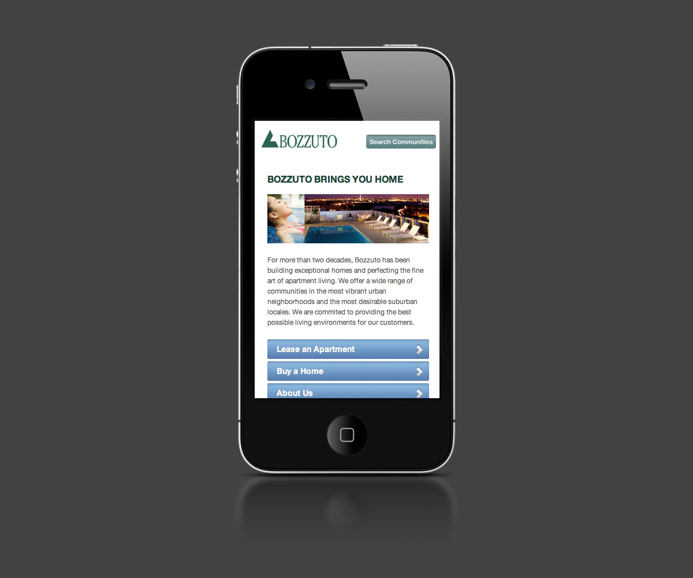
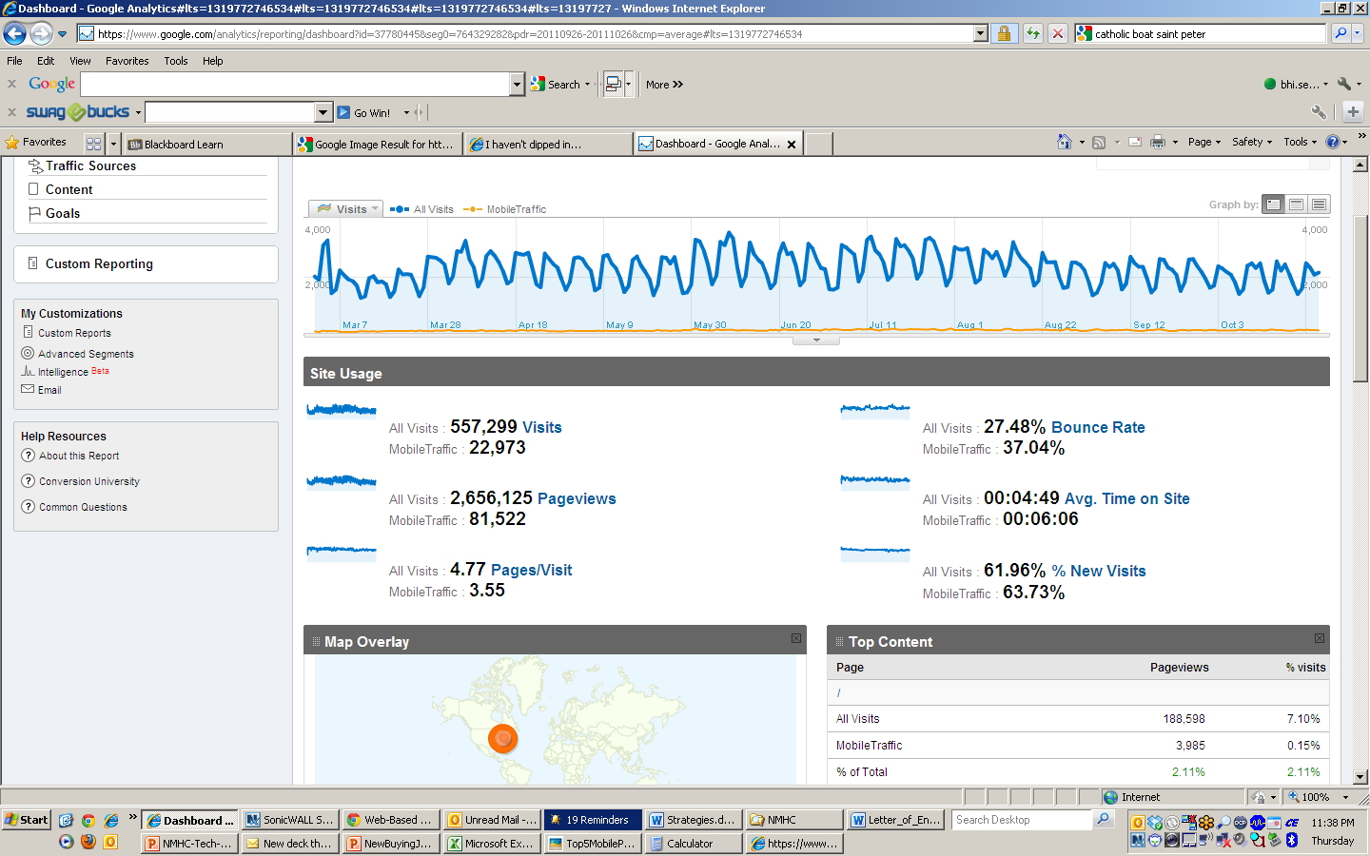
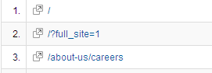
BOZZUTO.COM MOBILE WEBSITE
5-15% of total traffic

Slide 6
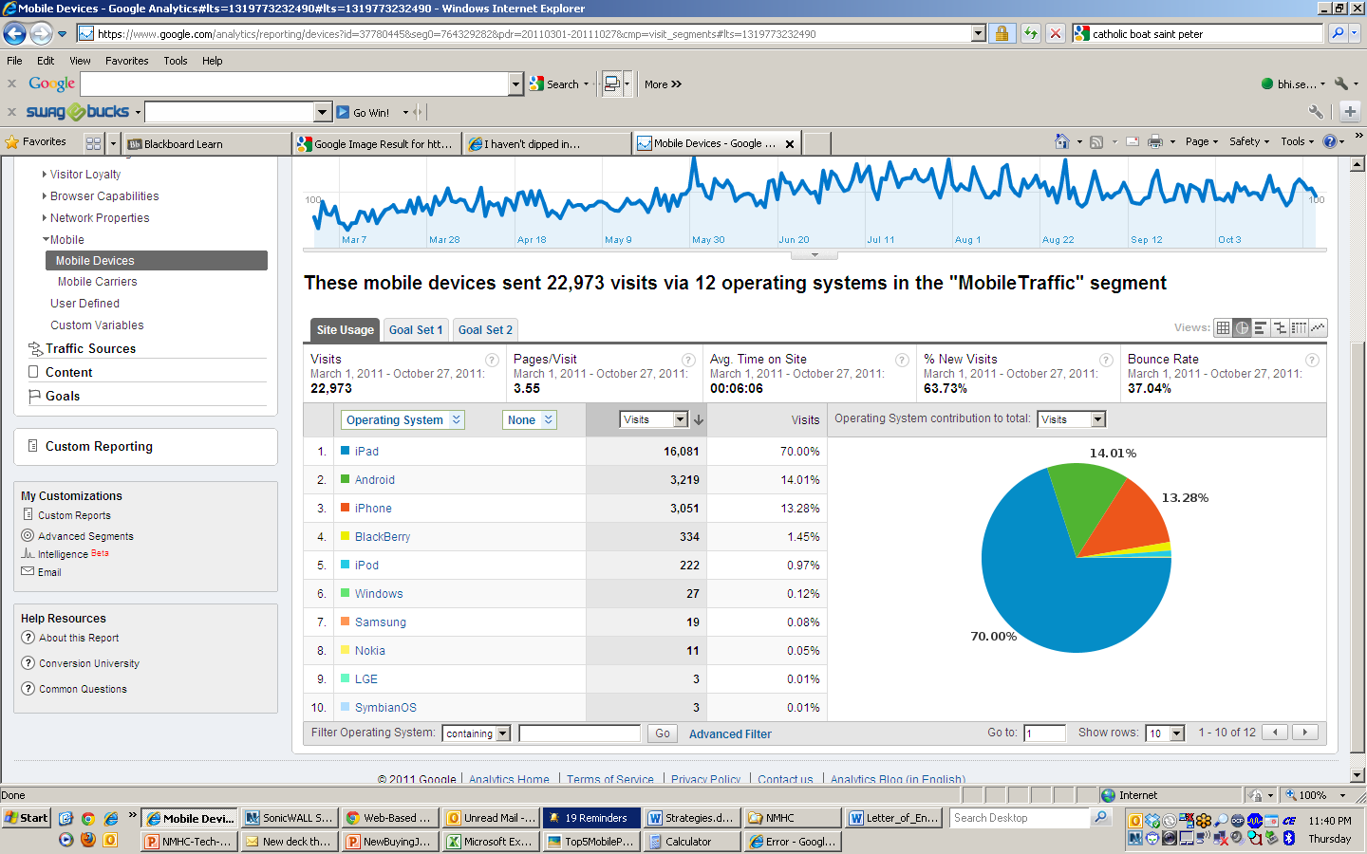

Slide 7
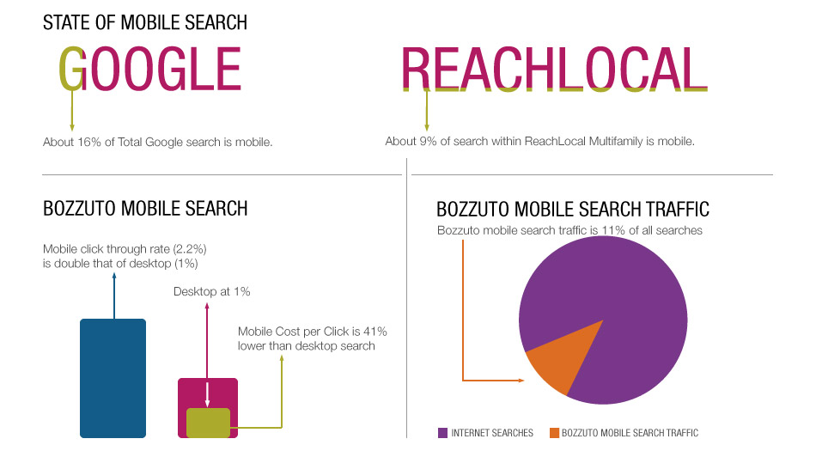
Mobile Search
Notes:
Capture the Market
VaultWare Mobile Stats
Bozzuto.com Stats
Reach Local Mobile Stats
State of mobile search
About 16% of total Google search is mobile.
About 9% of search within ReachLocal Multifamily is mobile.
Bozzuto mobile search
Mobile Cost Per Click is 41% lower than desktop search
Mobile Click Through Rate (2.2%) is double that of desktop (1%)
Bozzuto mobile search traffic is 11% of all searches

Slide 8
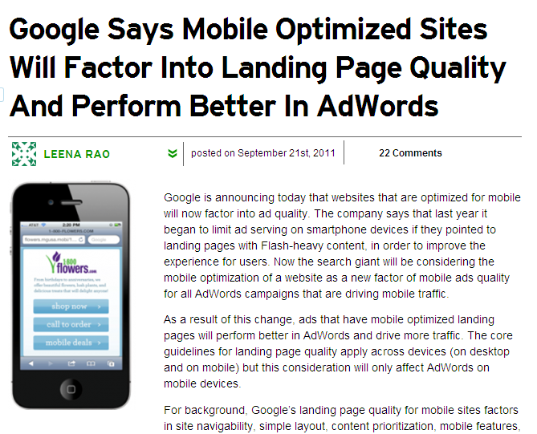
Mobile Performance
Notes:
Capture the Market
VaultWare Mobile Stats
Bozzuto.com Stats
Reach Local Mobile Stats

Slide 9
ABOUT THE
BOZZUTO GROUP

Slide 10
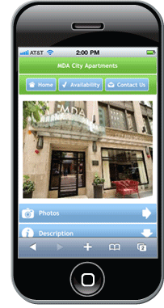
VS

Slide 11
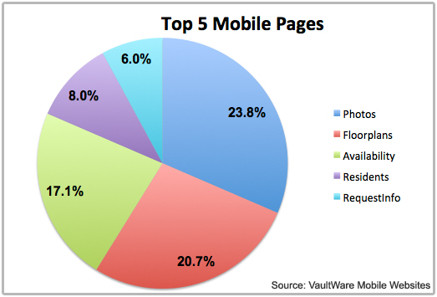
Mobile Performance
From Q2 2010 to Q2 2011 VaultWare's Mobile Reservation System increased by 146% per property.
Notes:
Capture the Market
VaultWare Mobile Stats
Bozzuto.com Stats
Reach Local Mobile Stats

Slide 12
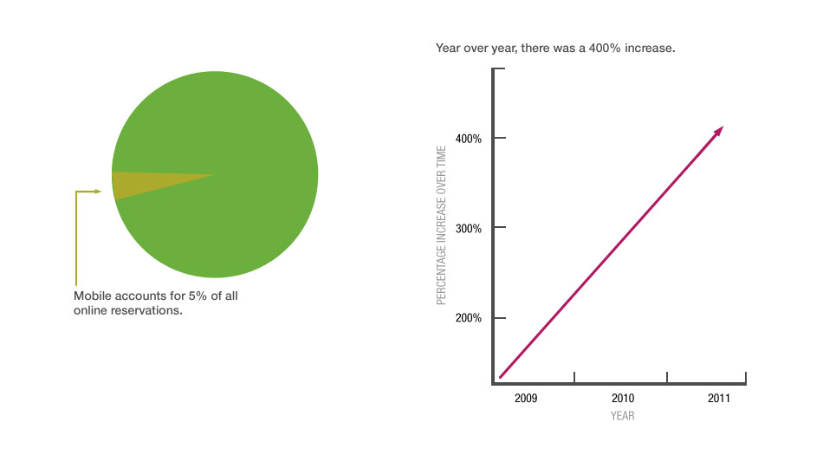
Mobile Reservations
Notes:
Mobile accounts for 5% of all online reservations
Year over year, there was a 400% increase

Slide 13
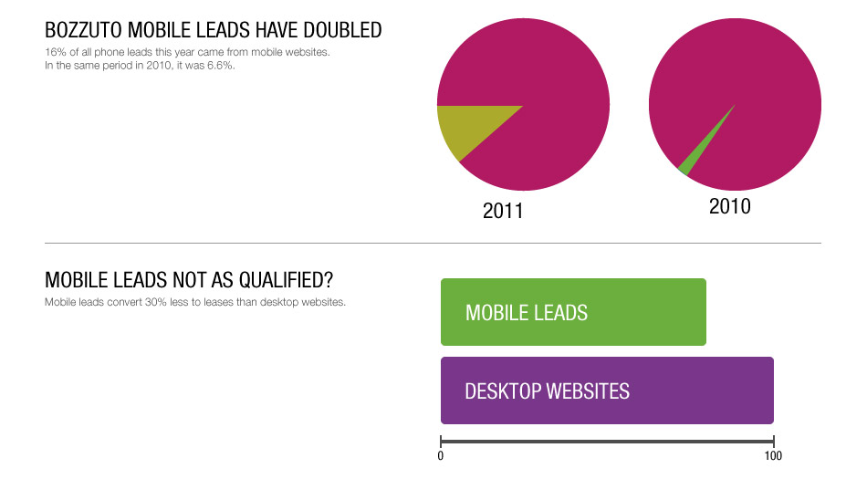
Mobile Performance
Notes:
Bozzuto mobile leads have doubled
16% of all phone leads this year came from mobile websites. In the same period in 2010, it was 6.6%.
Mobile leads not as qualified?
Mobile leads convert 30% less to leases than desktop websites

Slide 14
QR Codes

Slide 15
SMART PHONE USERS
72 percent likely to recall an advertisement that
featured a QR code.
32 percent have used a QR code, much higher
percentage than other previous surveys of QR usage.
More striking, the vast majority – 70 percent – of
respondents said they plan to use a QR code.

Slide 16
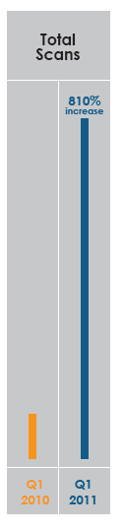
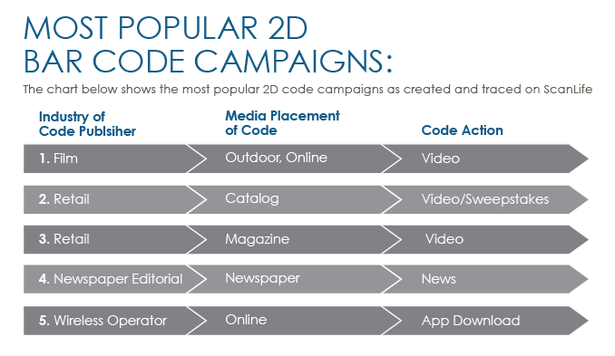
QR Codes

Slide 17
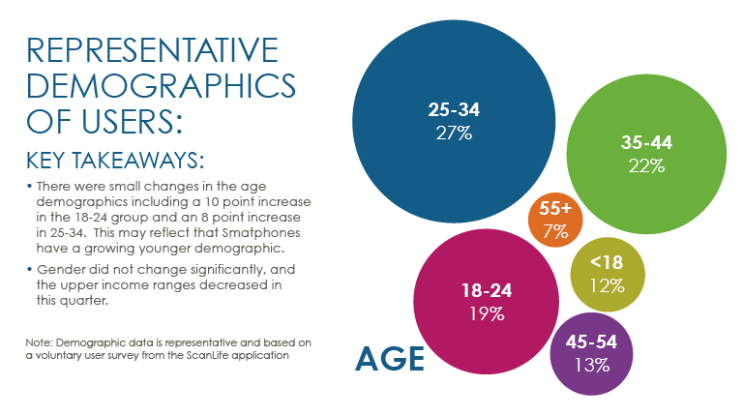
QR Codes

Slide 18
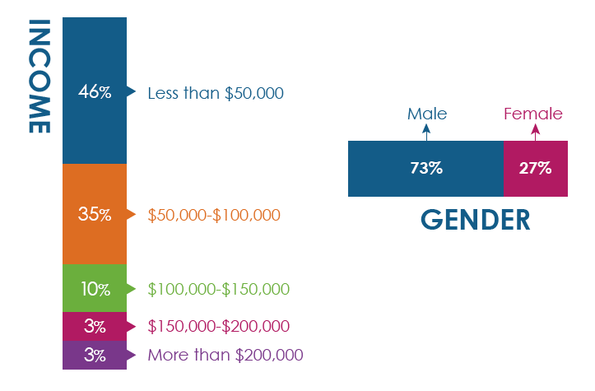
QR Codes

Slide 19
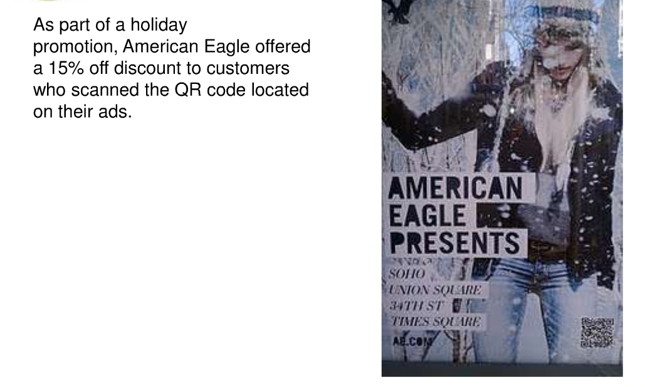
QR Codes

Slide 20
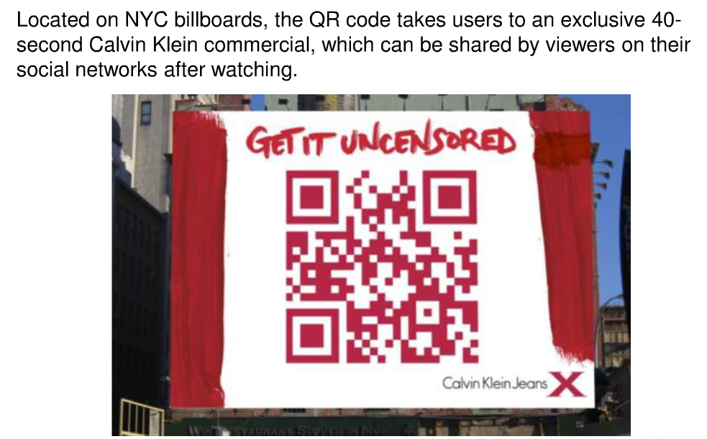
QR Codes

Slide 21
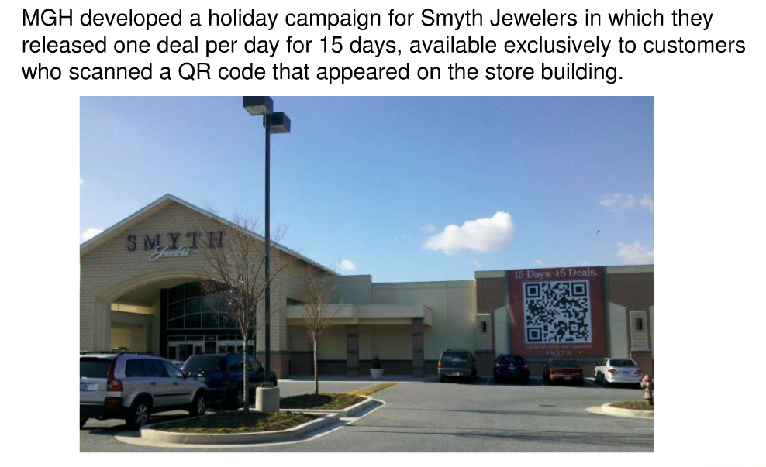
QR Codes

Slide 22
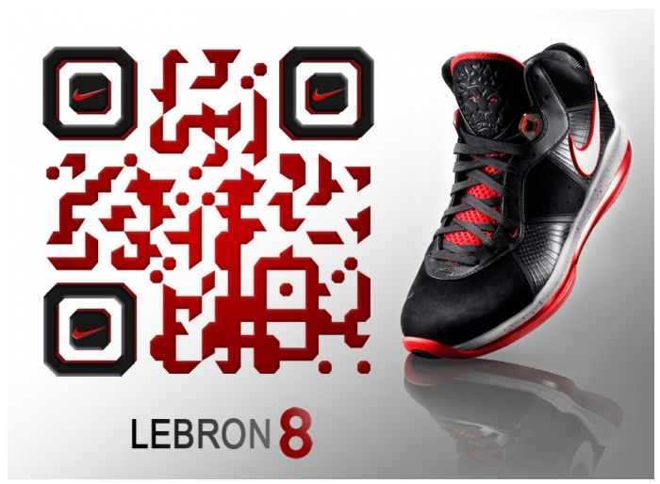
QR Codes

Slide 23
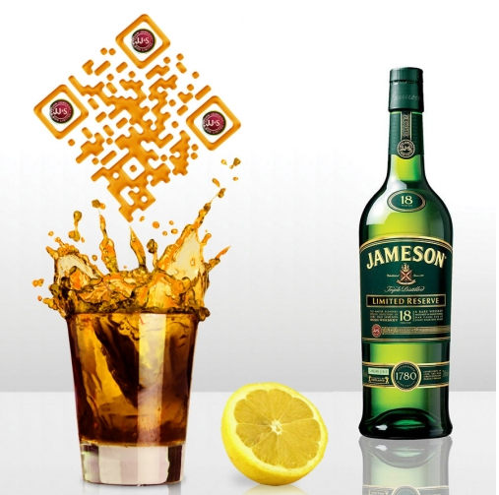
QR Codes

Slide 24
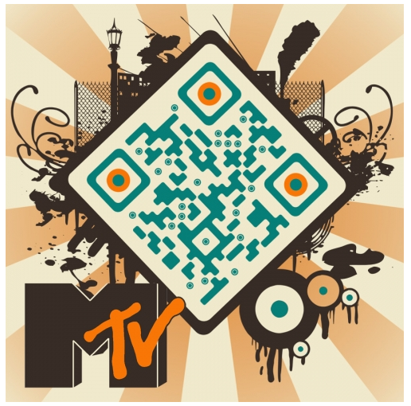
QR Codes

Slide 25
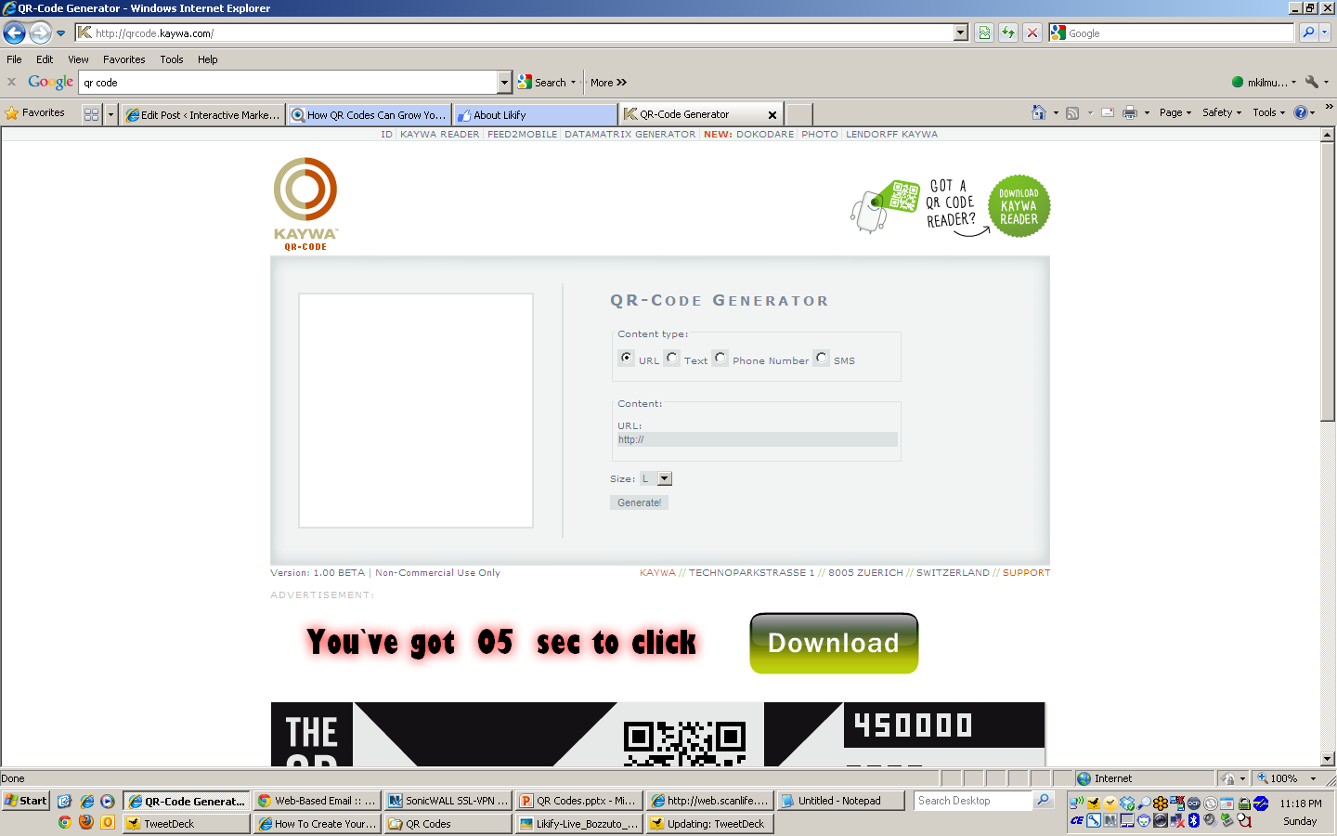
QR Codes

Slide 26
QR Codes
PAUSE – Before you send customers to the homepage of your website

Slide 27
QR Codes
Bookmark a website
Make a phone call
Send an SMS text
Send an E-Mail
Create a vCard
Create a vCalendar Event
Google Maps
Bing Maps
Download App in iTunes or Android Marketplace
Foursquare Check-In
Tweet on Twitter
Do a Google search for ‘Kerem Erkan’

Slide 28

QR Codes

Slide 29
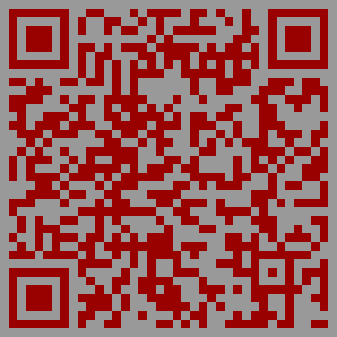
QR Codes

Slide 30
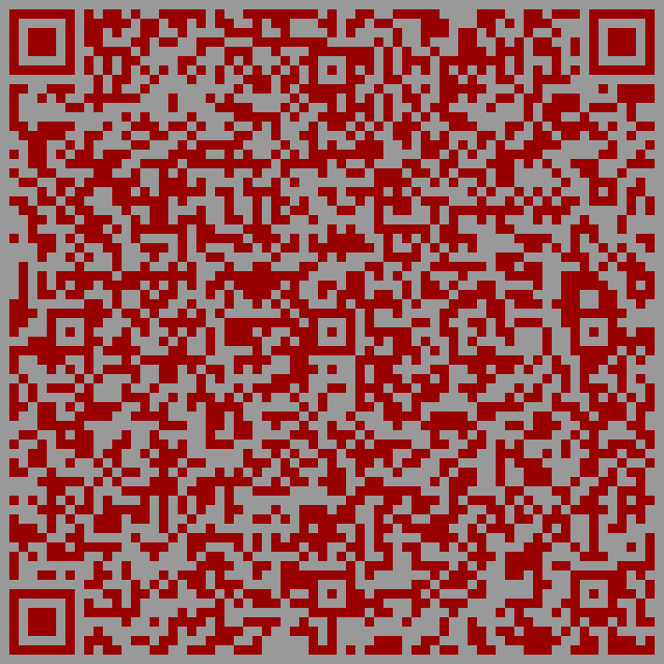
QR Codes

Slide 31
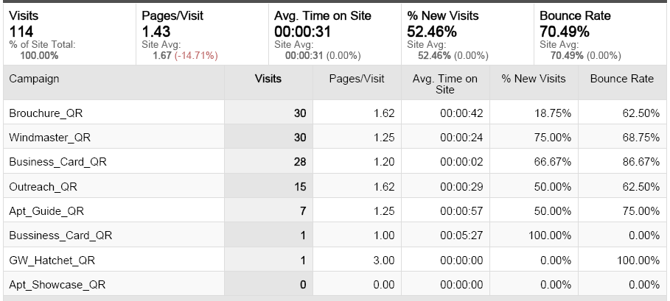
QR Codes

Slide 32
iPad Uses

Slide 33
iPAD USES
Is iPad truly a mobile device?

Slide 34




Live Digital Tours
Market is fragmented

Slide 35
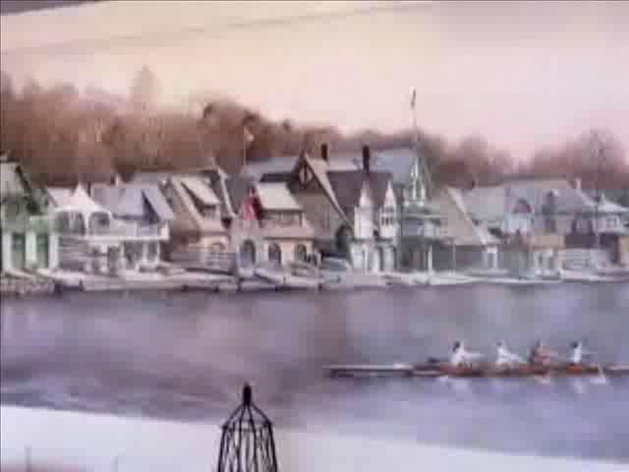
LIVE DIGITAL TOUR

Slide 36
LIVE DIGITAL TOUR

